Slide 1
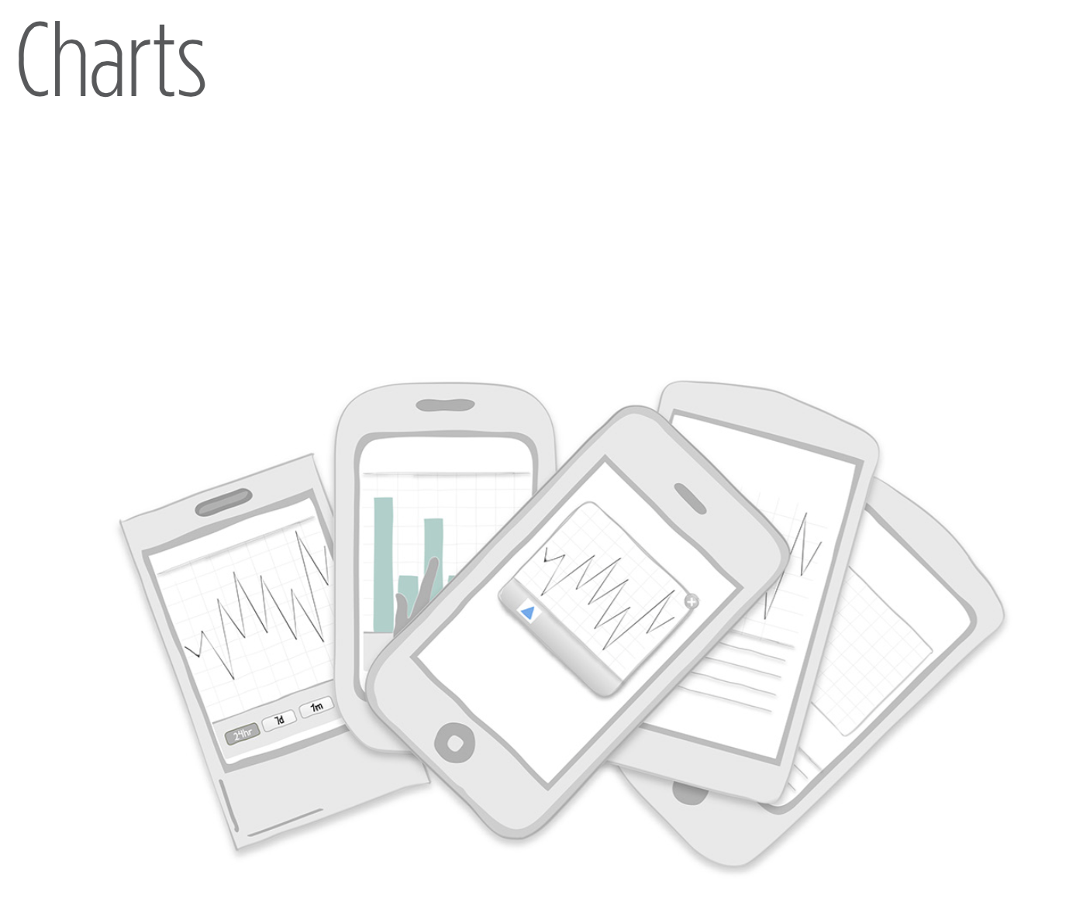
Notes:
Designing charts for the mobile form factor is a challenge. However, it also provides an opportunity to get to the very core of the best practices for data visualization. A chart should tell a story by depicting import- ant relationships in data. If it isn’t doing that, it is just a waste of space.

Slide 2
Many of the guidelines and best practices for print and desktop chart design apply to mobile chart design as well.
It’s not easy to get it right.
At a minimum, the necessary information will include a chart title, clearly labeled axes, and the data.
Notes:
http://www.slideshare.net/idigdata/data-visualization-best-practices-2013

Slide 3
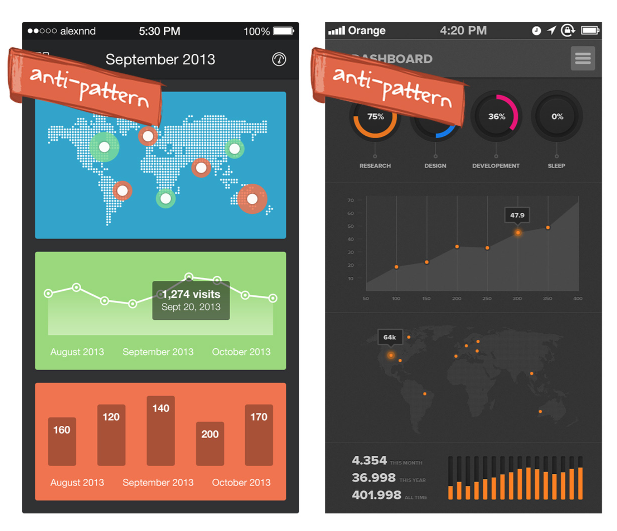
Notes:
FIGURE 6-1.
While pretty, these design examples found on Dribbble are uninformative and confusing

Slide 4
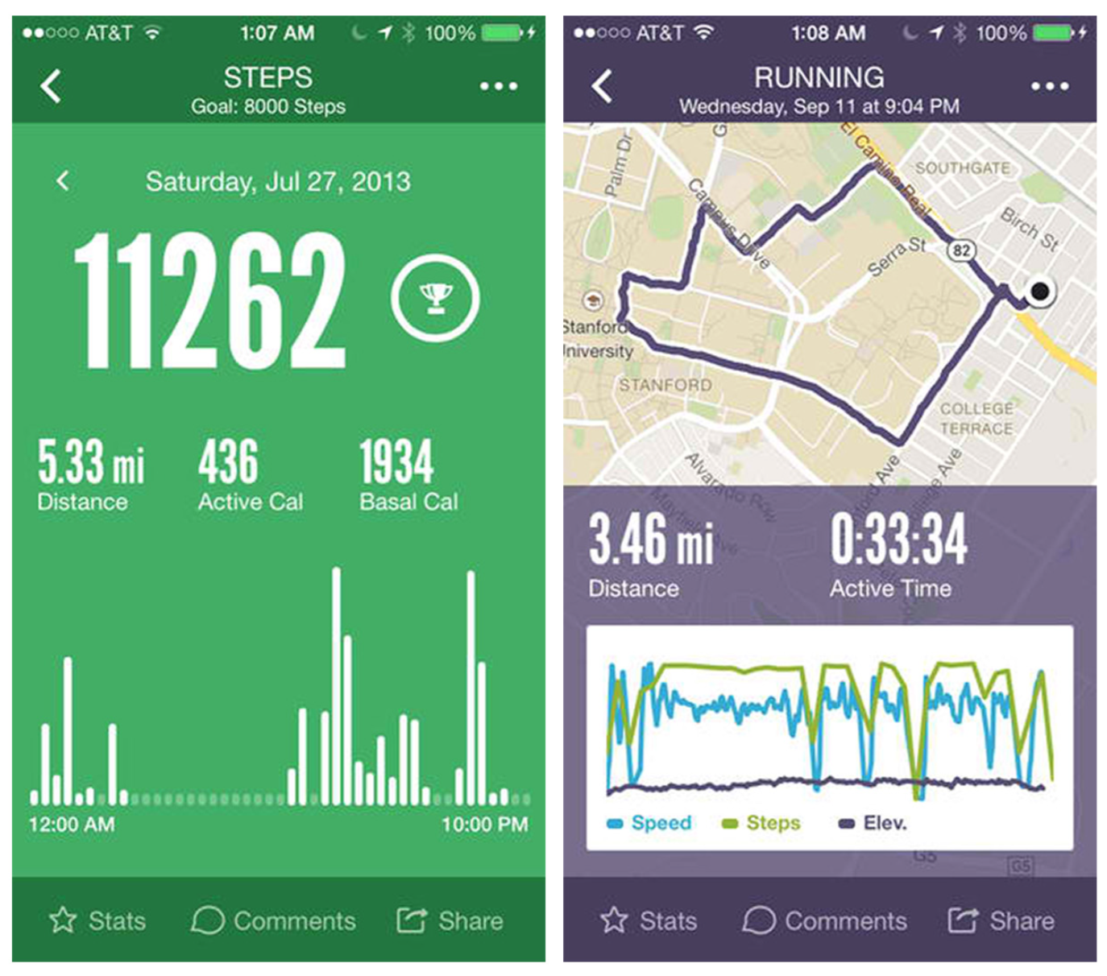
Notes:
FIGURE 6-2.
Argus for iOS 7: simple
column and line charts communicate the user’s progress toward fitness
goals

Slide 5
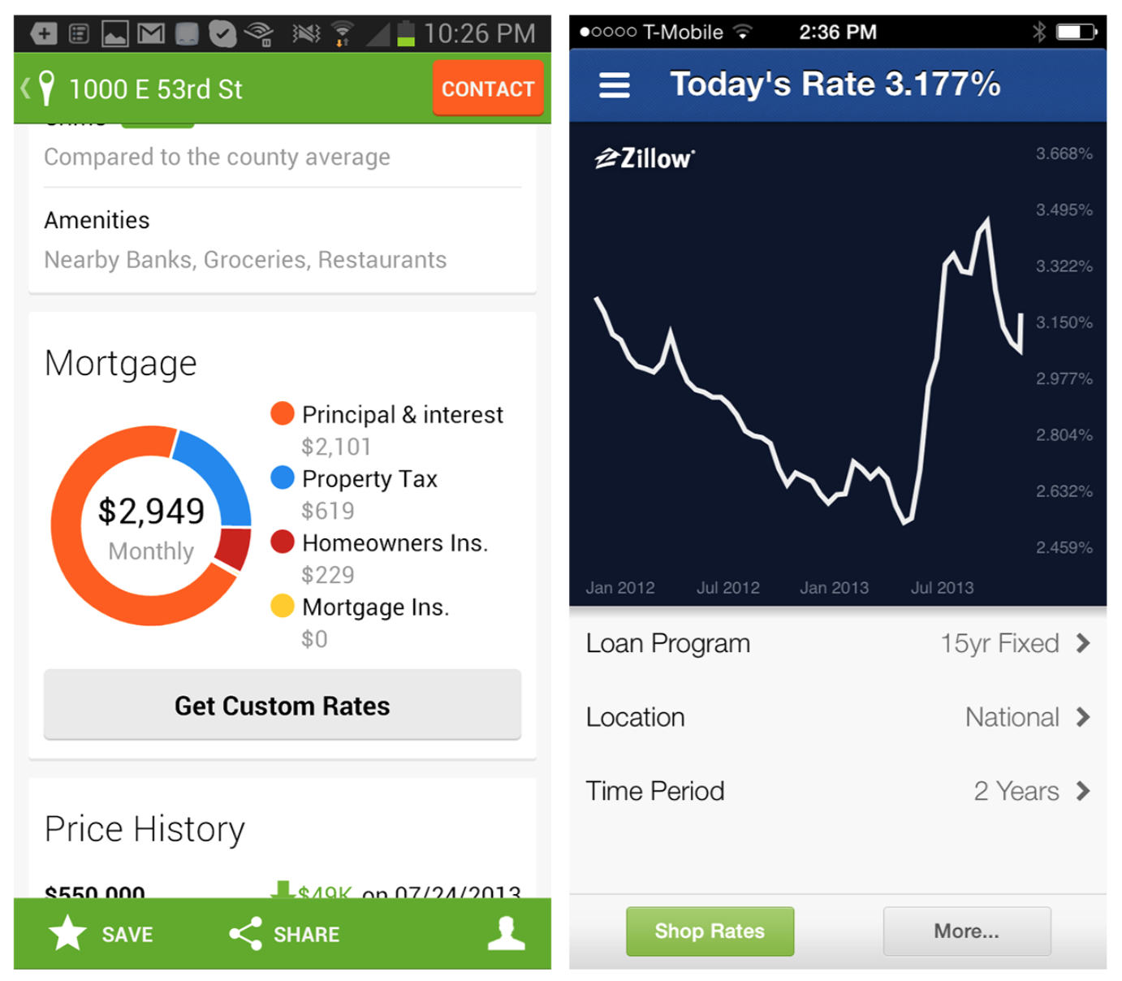
Notes:
FIGURE 6-3.
Simplicity rules: donut chart in Trulia for Android and line chart in Zillow Mortgage Calculator for iOS

Slide 6
So your chart looks good and everyone on your team likes it. Now the question is, will your users understand it?
To find out, when you conduct your user testing, write the usability script like a math test. Ask the participants specific questions about the data.
If they can’t answer them, the chart is either the wrong type, too complicated, or missing critical labels—or possibly all three.

Slide 7
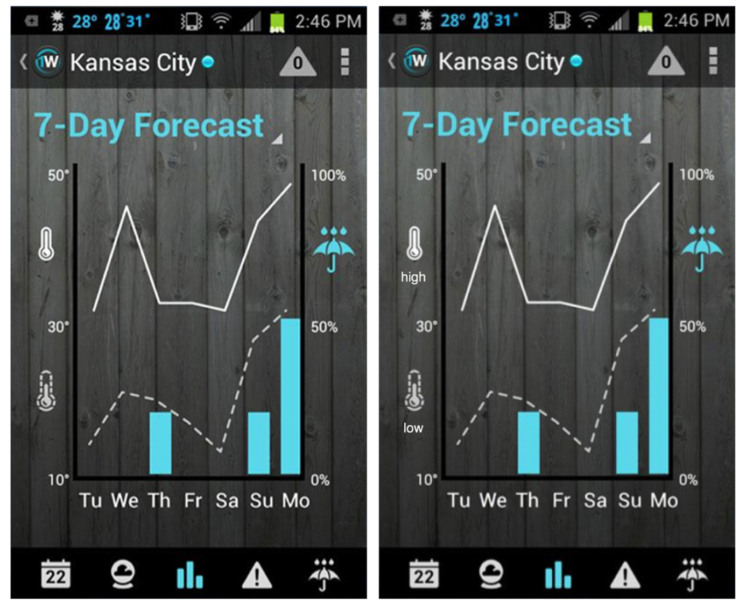
Notes:
FIGURE 6-4.
1Weather for Android: missing legend on left, added legend on right
For instance, in testing the chart from 1Weather for Android, questions I might ask the participant would include:
{ What time period does this chart cover? { What was the chance of rain on Friday? What about on
Monday? { Which day this week will be the hottest? The coolest?
During testing, it would probably become apparent that partici- pants are unsure of the difference between the solid line and the dashed line. A simple label change could remedy this, but test again to be sure. I like to sketch along as participants respond (or ask the participants to sketch) during test sessions and iterate on the chart design until they can answer all the questions correctly.

Slide 8
Charting Libraries
Core Plot (https://code.google.com/p/core-plot/) for iOS
ShinobiControls (http://www.shinobicontrols.com/) for iOS and Android
TeeChart (https://components.xamarin.com/view/TeeChart) for Xamarin
TelerikRadControls (http://bit.ly/1fFcbGI) forWindowsPhone
A JS charting library like AnyChart
(http://www.anychart. com/products/anychart/gallery/) or
amCharts (http://www. amcharts.com/)

Slide 9
Chart with Filters
A simple chart can be enhanced with time controls or other filters. In apps like Fidelity and StockPlus, the data can be explored for different time periods.
When you design an Onscreen Filter, provide plenty of space for the touch target.

Slide 10
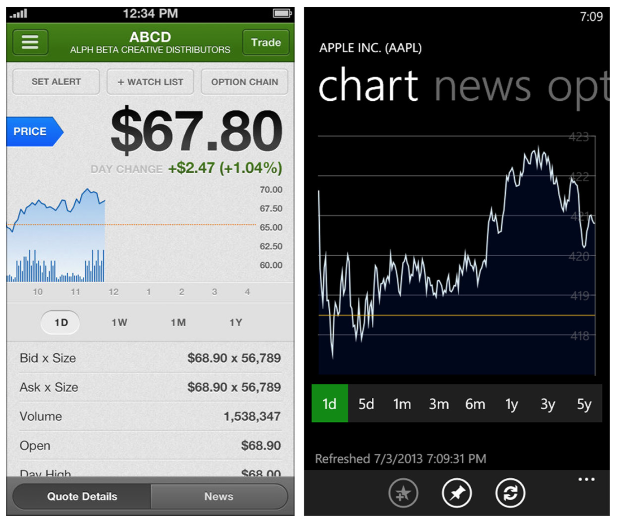
Notes:
FIGURE 6-5.
Fidelity for iOS and StockPlus for Windows Phone: time period filtering

Slide 11
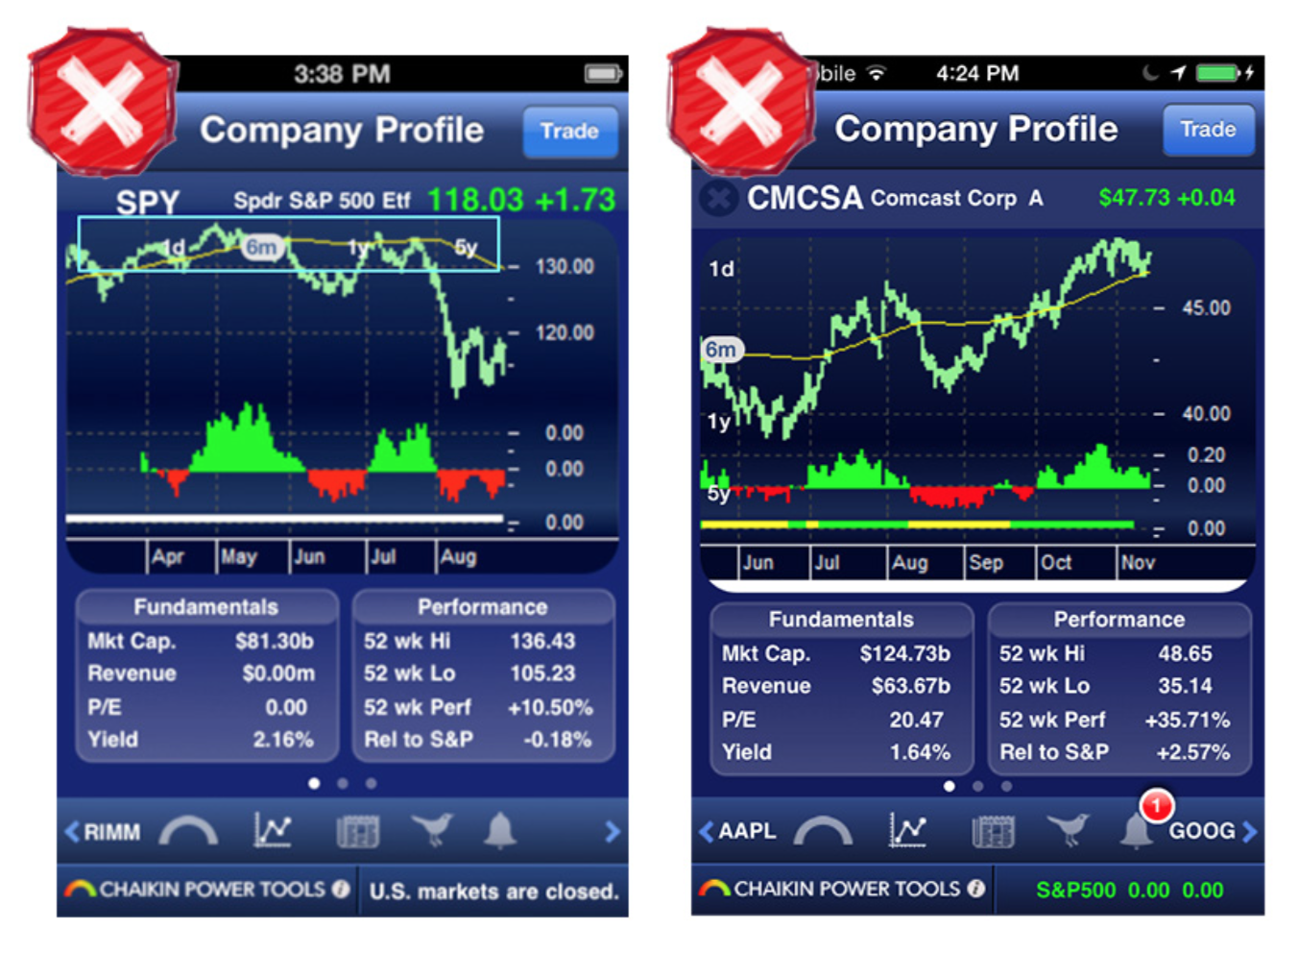
Notes:
FIGURE 6-6.
Two generations of Chaikin for iOS: filter controls are still hard to see

Slide 12
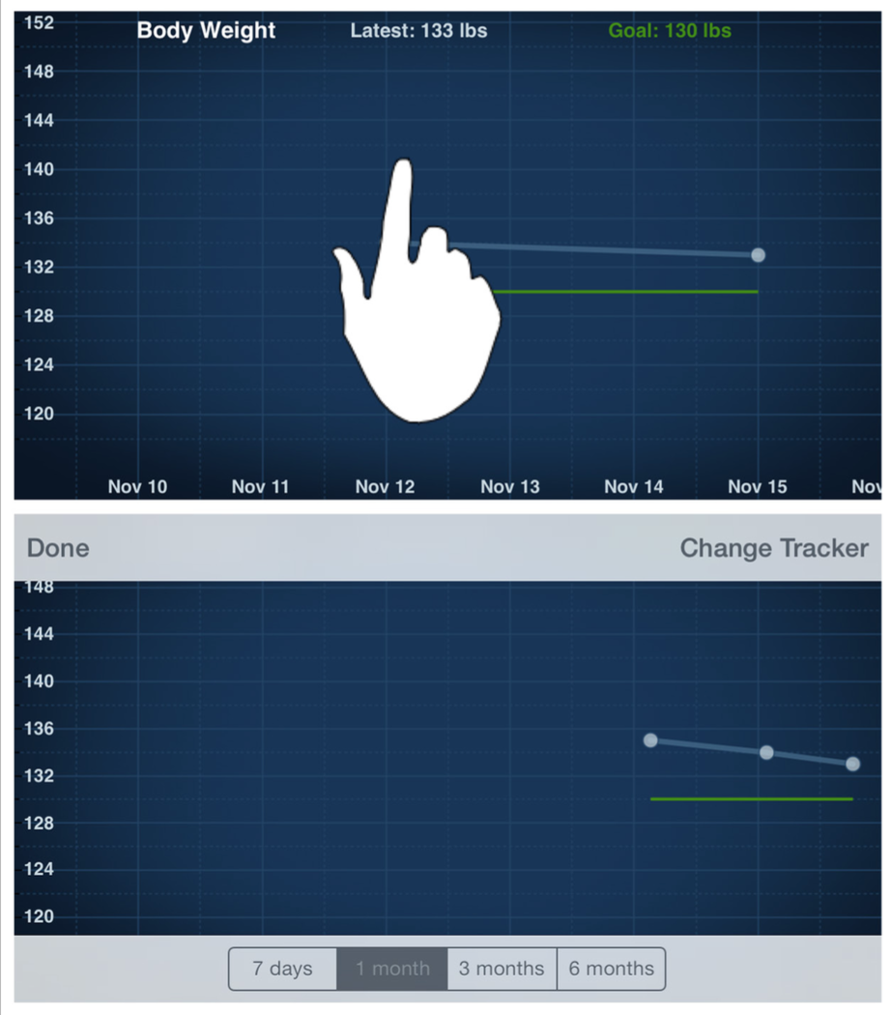
Notes:
FIGURE 6-7.
DailyBurn Tracker for iOS: tapping the chart reveals filters

Slide 13
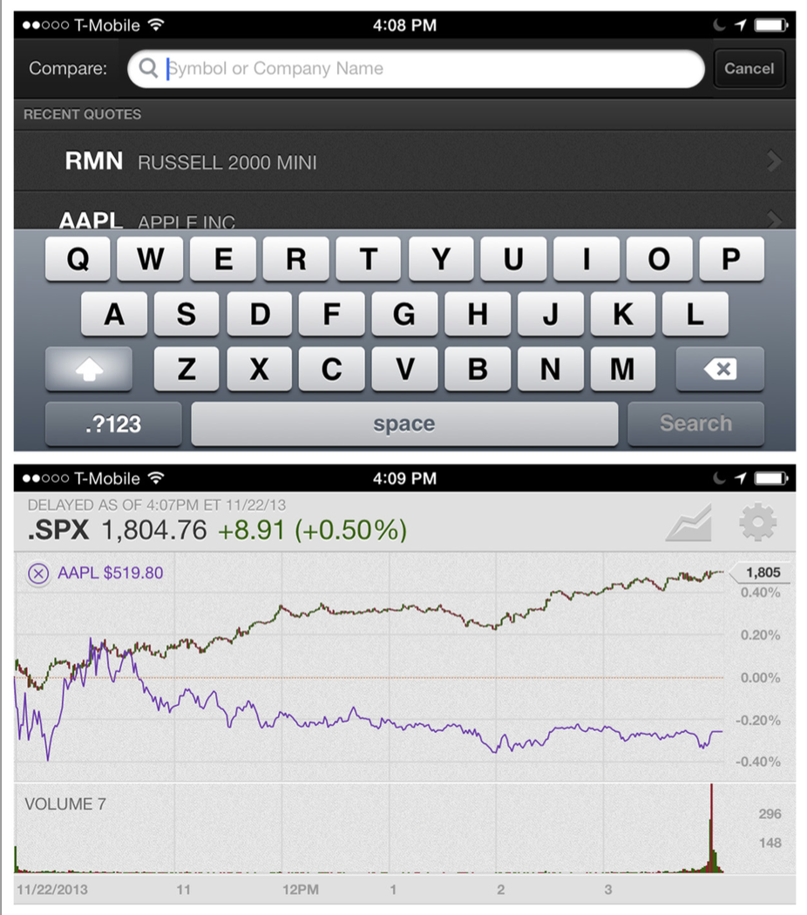
Notes:
FIGURE 6-8.
Fidelity for iOS: data source comparisons

Slide 14
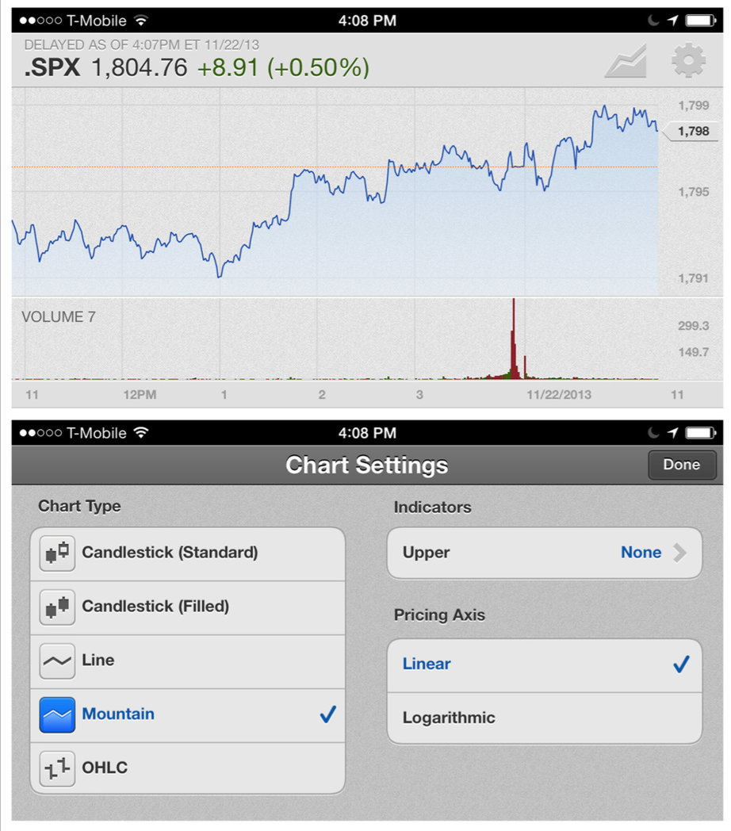
Notes:
FIGURE 6-9.
Fidelity for iOS: comparisons and configuration
The Fidelity app also offers configuration options for changing the chart type, thresholds, and pricing axis.
[ NOTE ]
Use common patterns for filtering, like the OnScreen Filter, Filter Drawer, and Filter Form (see Chapter 4).

Slide 15
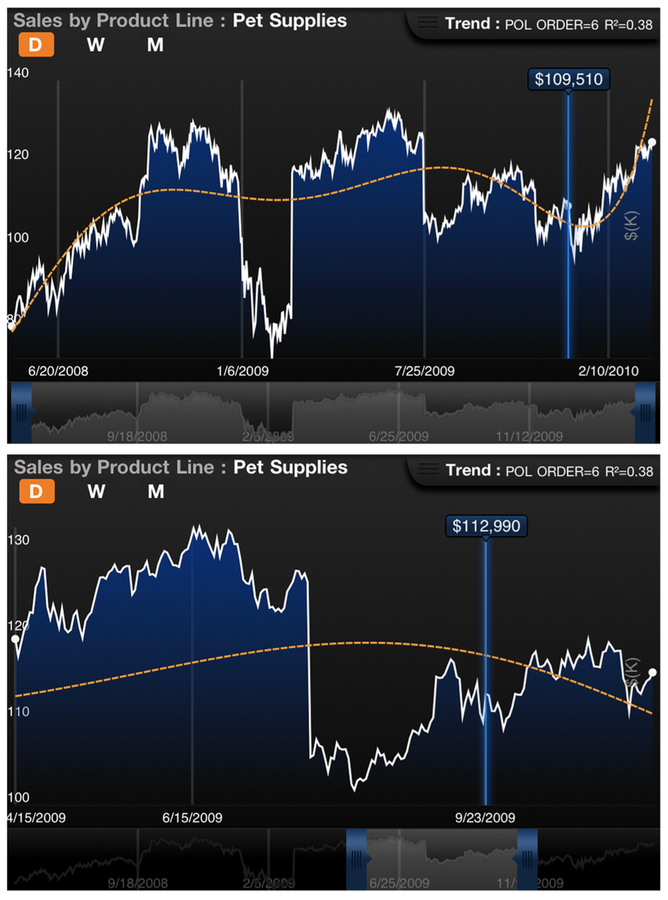
Notes:
FIGURE 6-10.
Roambi for iOS: handles for selecting a window in time
An Interactive Timeline can provide users with more freedom and control in selecting context than a static chart or visualization.

Slide 16
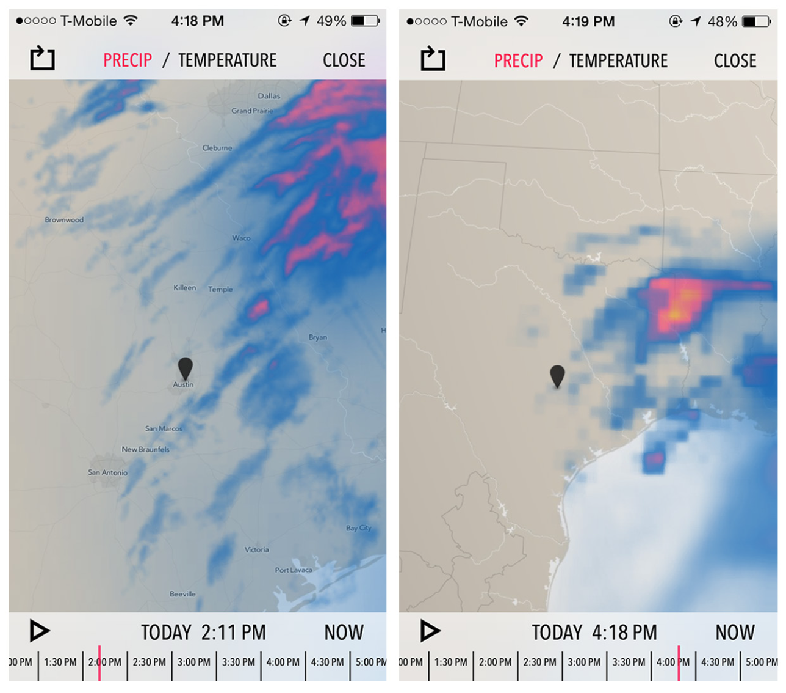
Notes:
FIGURE 6-11.
Dark Sky for iOS: Interactive Timeline plus Play button (http://youtu. be/d_ZJYVPxRe8)

Slide 17
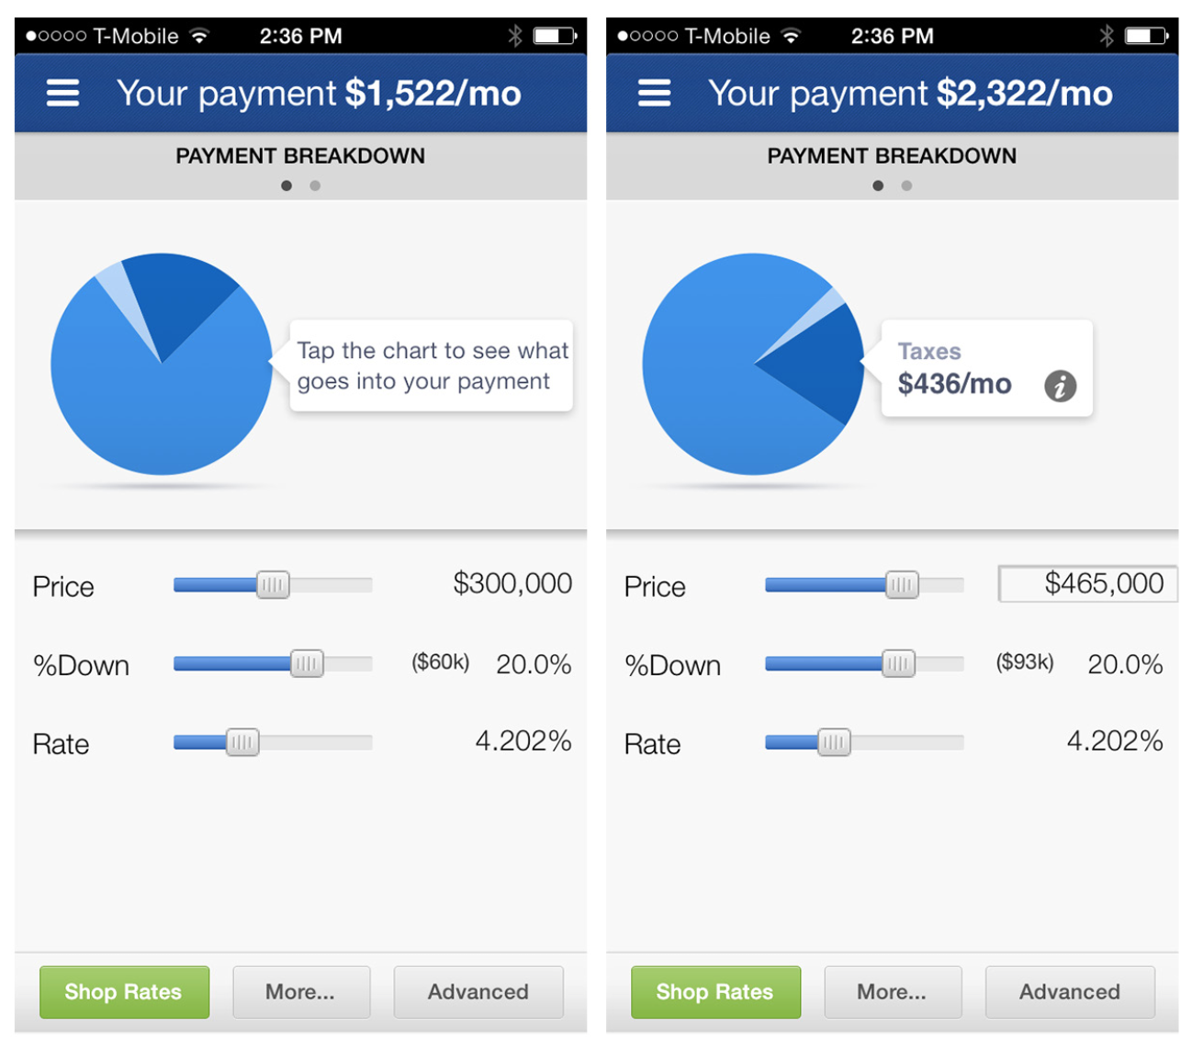
Notes:
FIGURE 6-12.
Zillow Mortgage Calculator for iOS: touching the chart area reveals Data Point Details
Data Point Details
Since hover doesn’t exist in mobile and long press isn’t very intuitive, a different interaction is needed to show details for a specific data point. In the Zillow Mortgage Calculator for iOS, touching a wedge in the pie chart displays details about the payment breakdown.

Slide 18
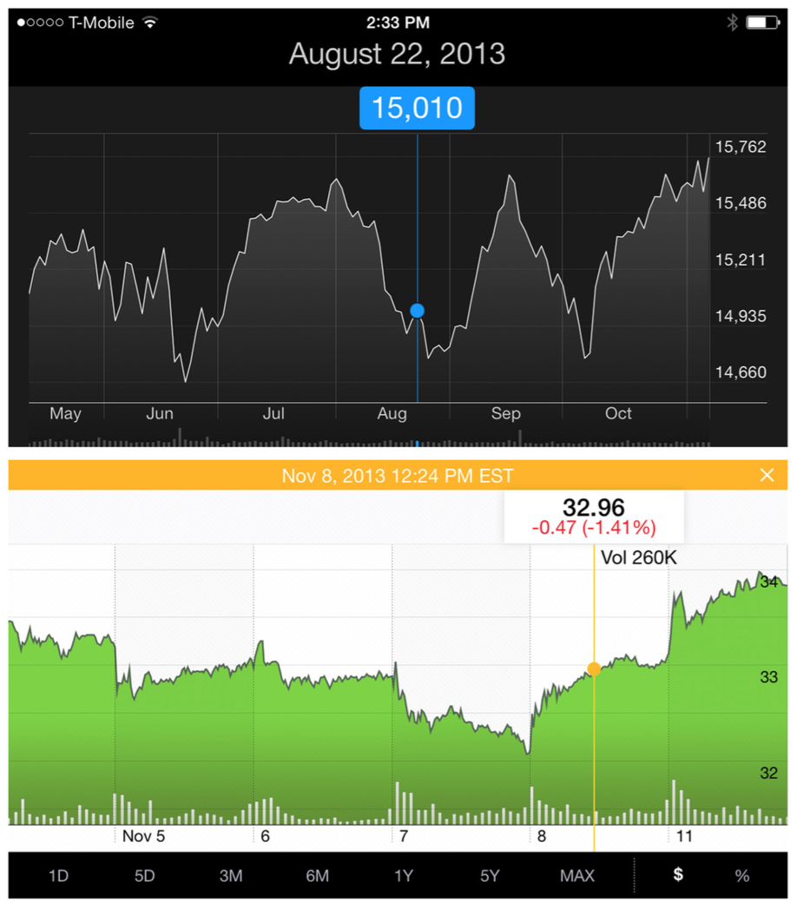
Notes:
FIGURE 6-13.
Apple Stocks and Yahoo! Finance for iOS: tap data points for more info
In Apple Stocks and Yahoo! Finance, tapping a data point highlights it in the Preview Window at the bottom of the chart (although you have to look pretty closely to see it). In these apps, the whole chart is a touch target, so you can tap anywhere, and then drag to zero in on the specific date.

Slide 19
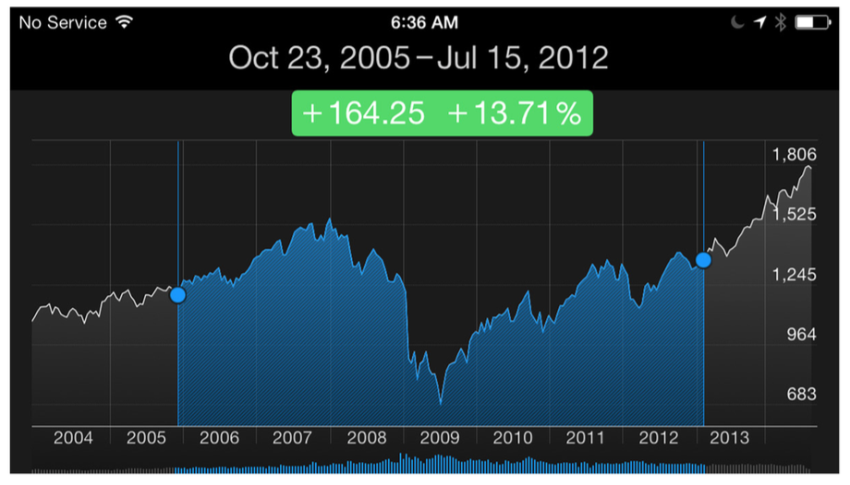
Notes:
FIGURE 6-14.
Apple Stocks for iOS: single and multitouch Data Point Details
In the Apple Stocks app, a single touch shows the details for that data point, but touching two points (multitouch) shows the difference between the two points.

Slide 20
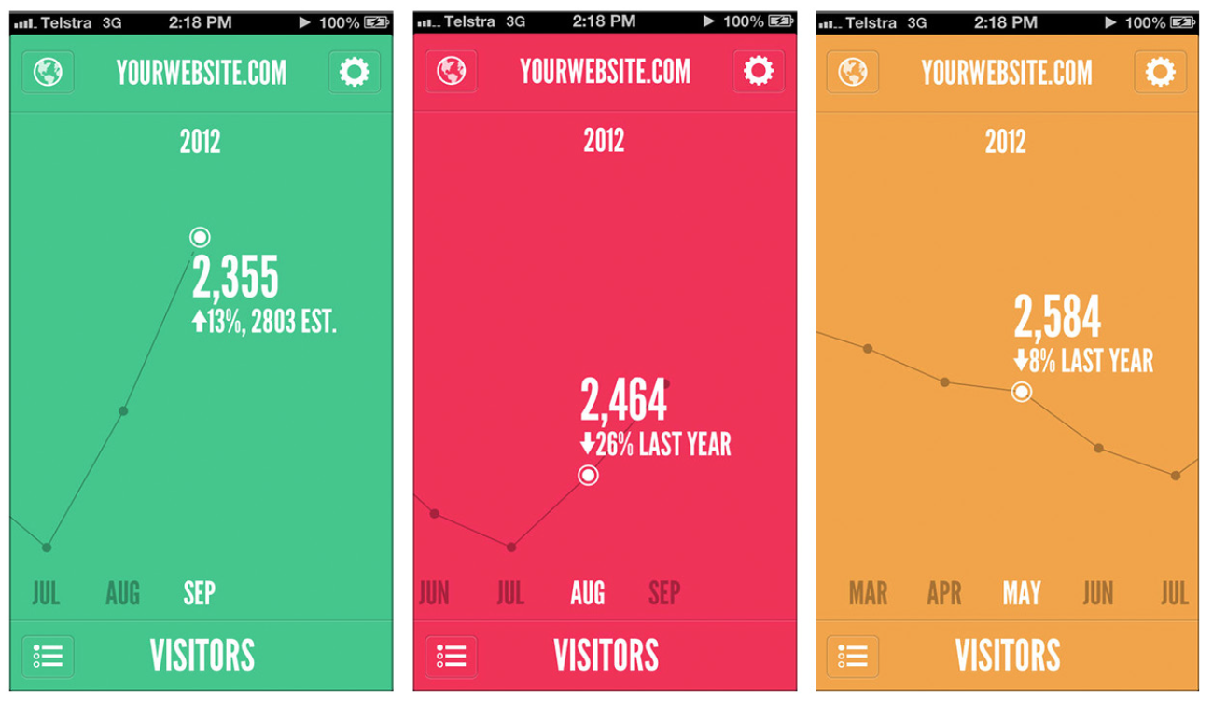
Notes:
FIGURE 6-15.
Traffic for Google Analyticsfor iOS: ges- tures let you explore Data Point Details and change time periods (http://www. youtube.com/watch ?v=UqZkxNT3Ggs)
In its iOS 7 release, Roambi has introduced a clever way to toggle between multiple data sources to see their details by just tapping on the drag handle.

Slide 21
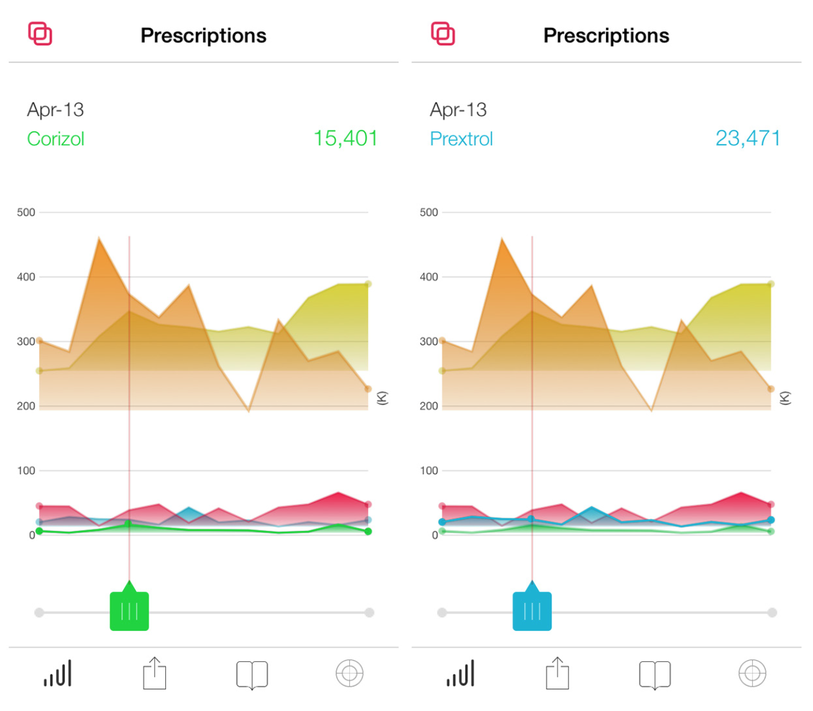
Notes:
FIGURE 6-16.
Roambi for iOS: Data Point Detail toggle (http://www. youtube.com/watch ?v=XBipN_7XMnU)

Slide 22
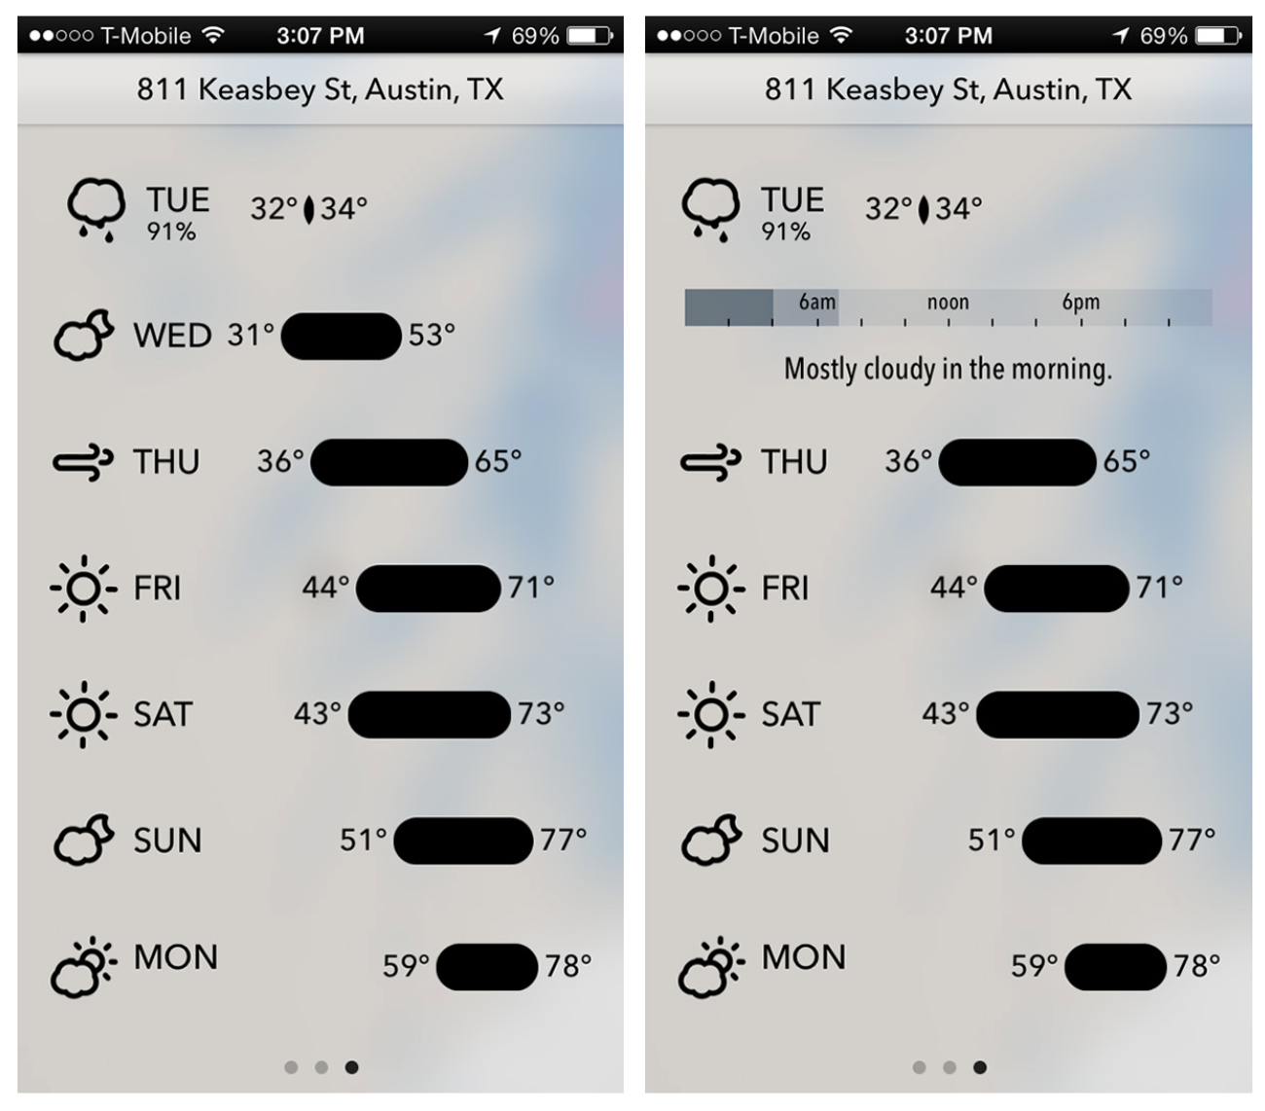
Notes:
FIGURE 6-17.
Dark Sky for iOS: swipe row for details (http://www. youtube.com/watch ?v=d_ZJYVPxRe8)
Dark Sky encourages users to swipe to see the details. When the week view loads, the first row “bumps” to invite a swipe action. Once the row is swiped, that day’s weather details are revealed.
Withings uses a combination of Data Point Details plus the Drill Down pattern, which we’ll look at in more detail next. Tapping on the data point shows the details; then, tapping on the details overlay drills down into a new screen for editing or taking other action.
Our web experiences have set the expectation that Data Point Details will be displayed on hover, which isn’t available in mobile apps. Consider serving details when data points are tapped to provide the additional information users want.

Slide 23
Drill Down
The Data Point Details pattern is usually sufficient for showing a bit more information in context. But sometimes users need to explore the data more deeply. That’s when the Drill Down pattern can be useful.

Slide 24
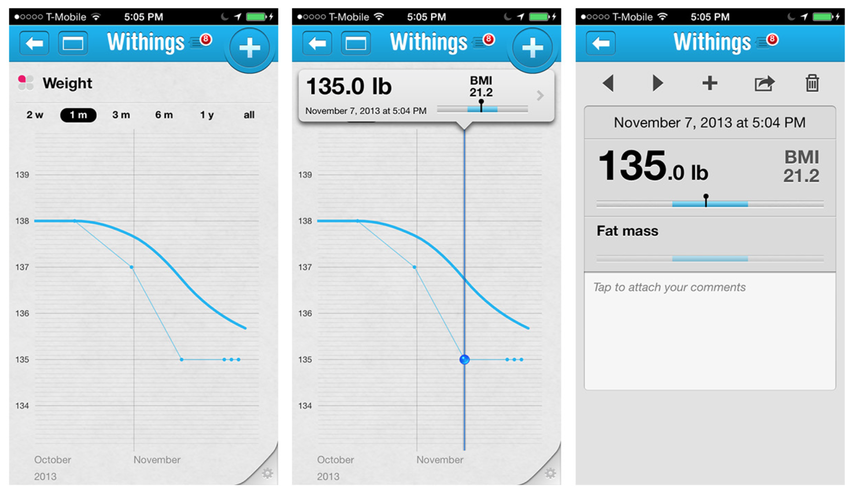
Notes:
FIGURE 6-18.
Withings for iOS: tapping the chart shows the Data Point Details; tapping the details navigates to a new screen with even more details

Slide 25
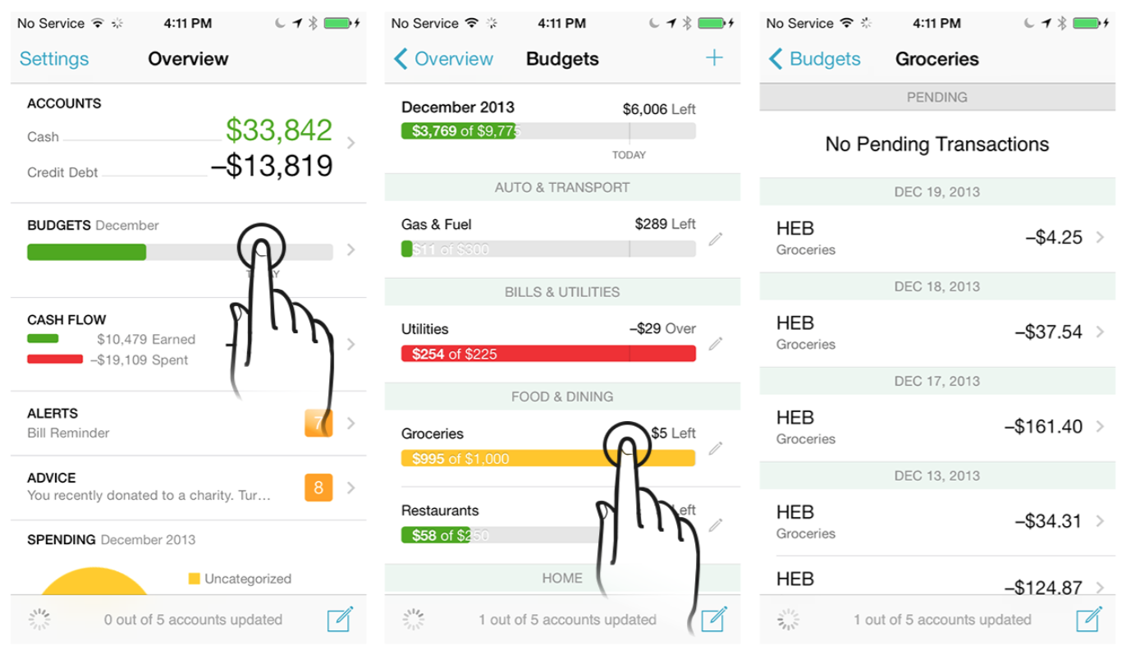
Notes:
FIGURE 6-19.
Mint for iOS: Drill Down reveals layers of details

Slide 26
Overview plus Data
This is one of the chart patterns that has evolved the most in the past couple of years.

Slide 27
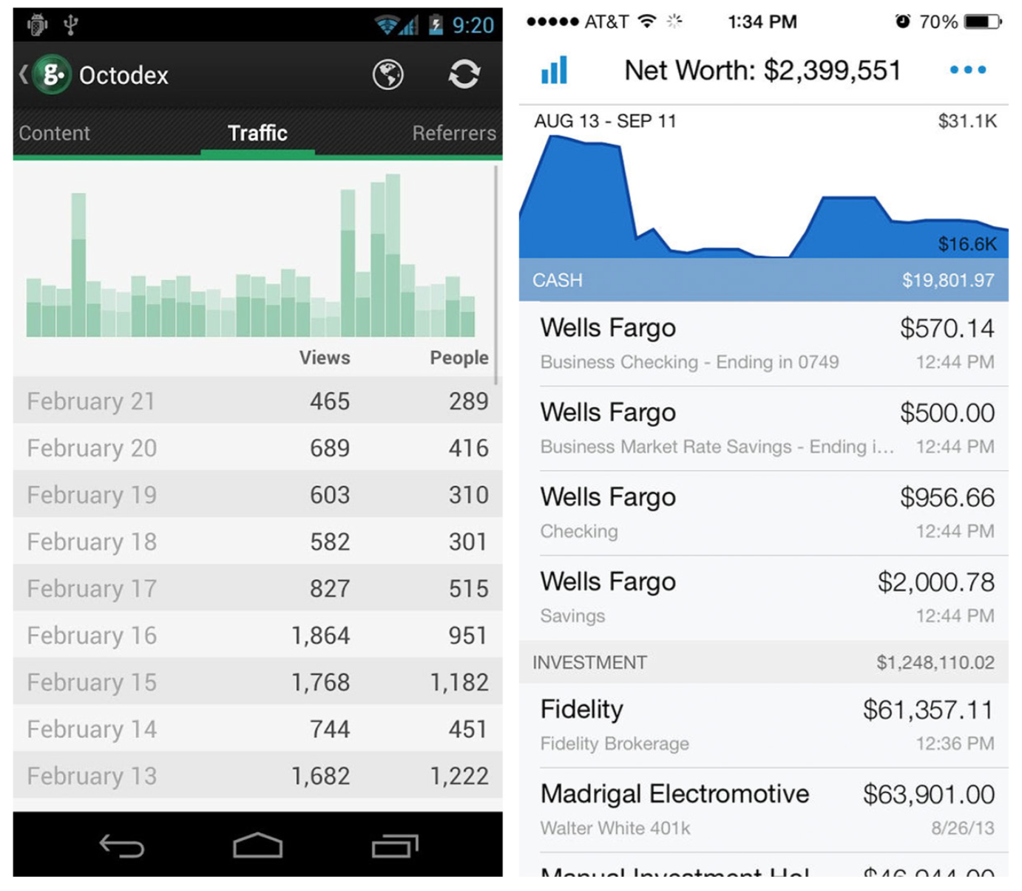
Notes:
FIGURE 6-20.
Gaug.es for Android and Personal Capital for iOS: trend chart on top, detailed table below

Slide 28
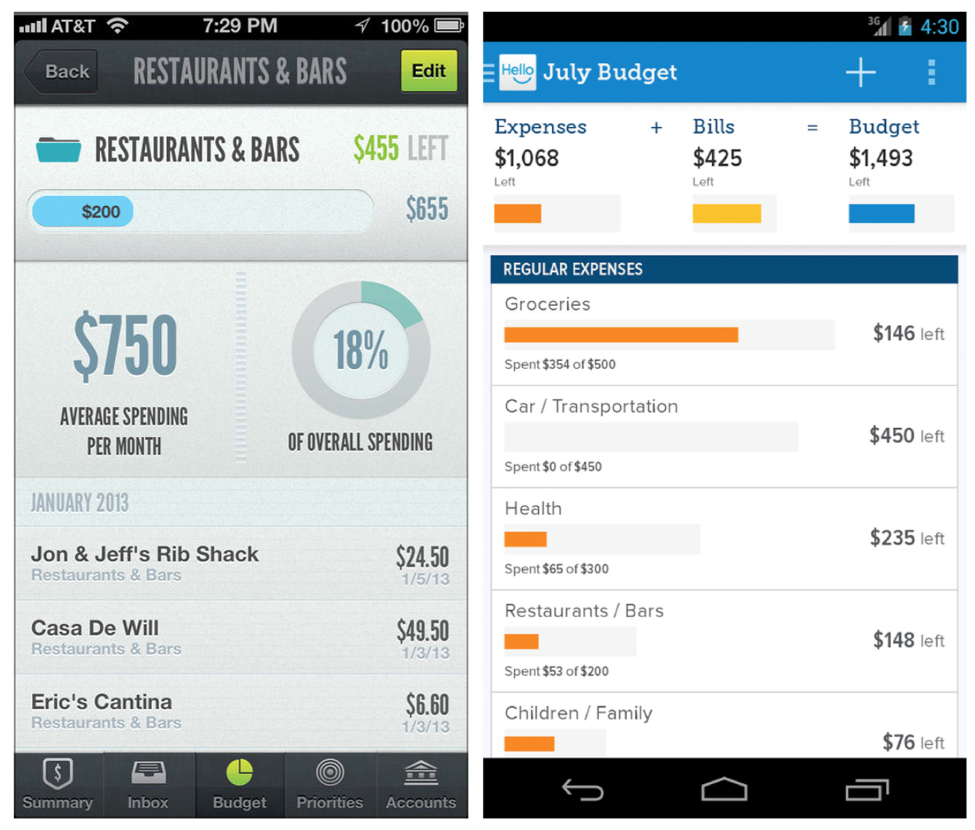
Notes:
FIGURE 6-21.
LearnVest for iOS and HelloWallet for Android

Slide 29
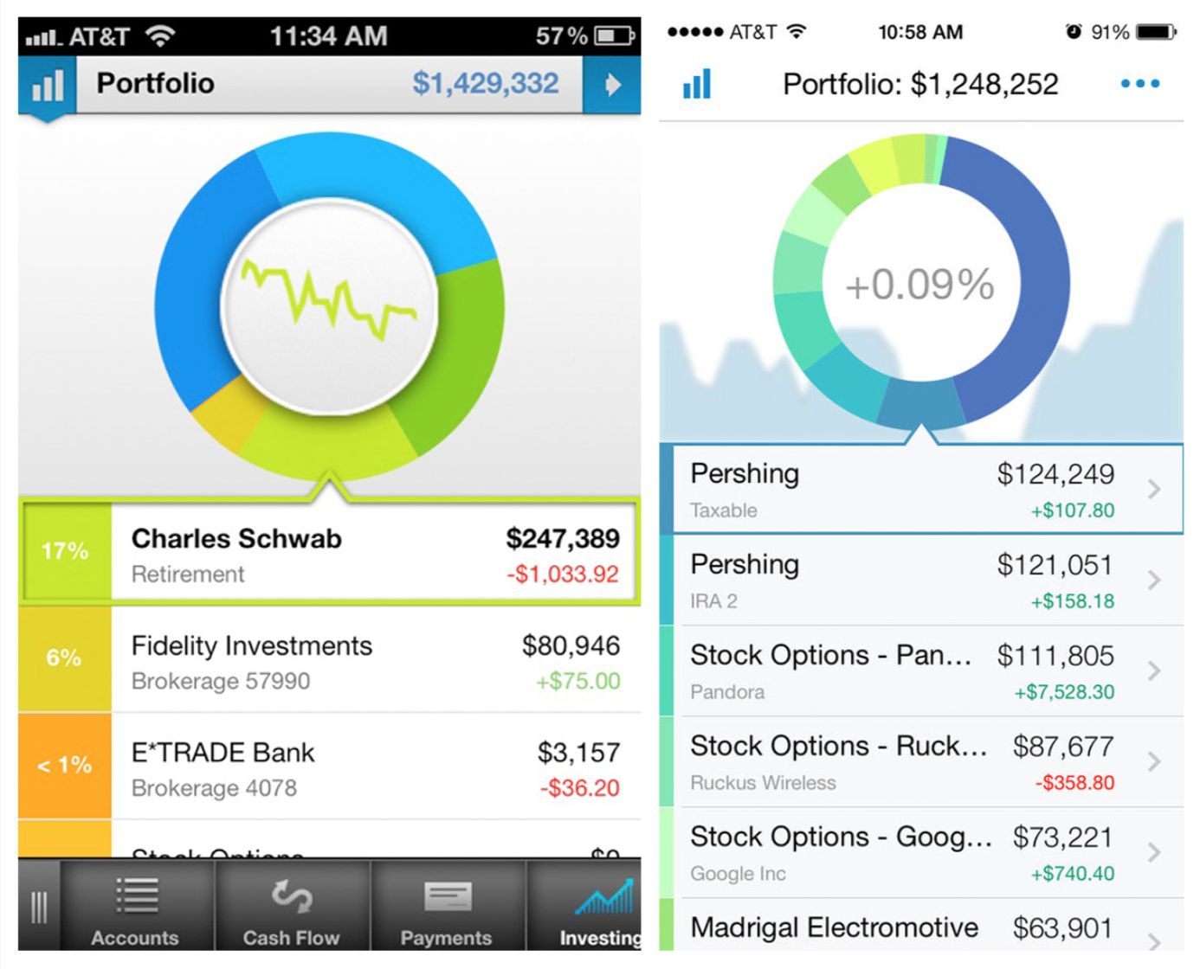
Notes:
FIGURE 6-22.
Two iterations of Personal Capital for iOS: Sparkline replaced by background area chart
But this pattern is not restricted to read-only charts and their respec- tive data tables. In Personal Capital, for example, an interactive donut chart is used for the overview. Tapping on a wedge highlights the cor- responding category and total in the table below.
An earlier version of the app featured a Sparkline (a type of very small chart, covered later in this chapter) in the middle of the donut, affording a bit more context around spending for this category. This has since been replaced with a number indicating the percent increase or decrease, plus an area chart in the background behind the donut showing the trends over time.

Slide 30
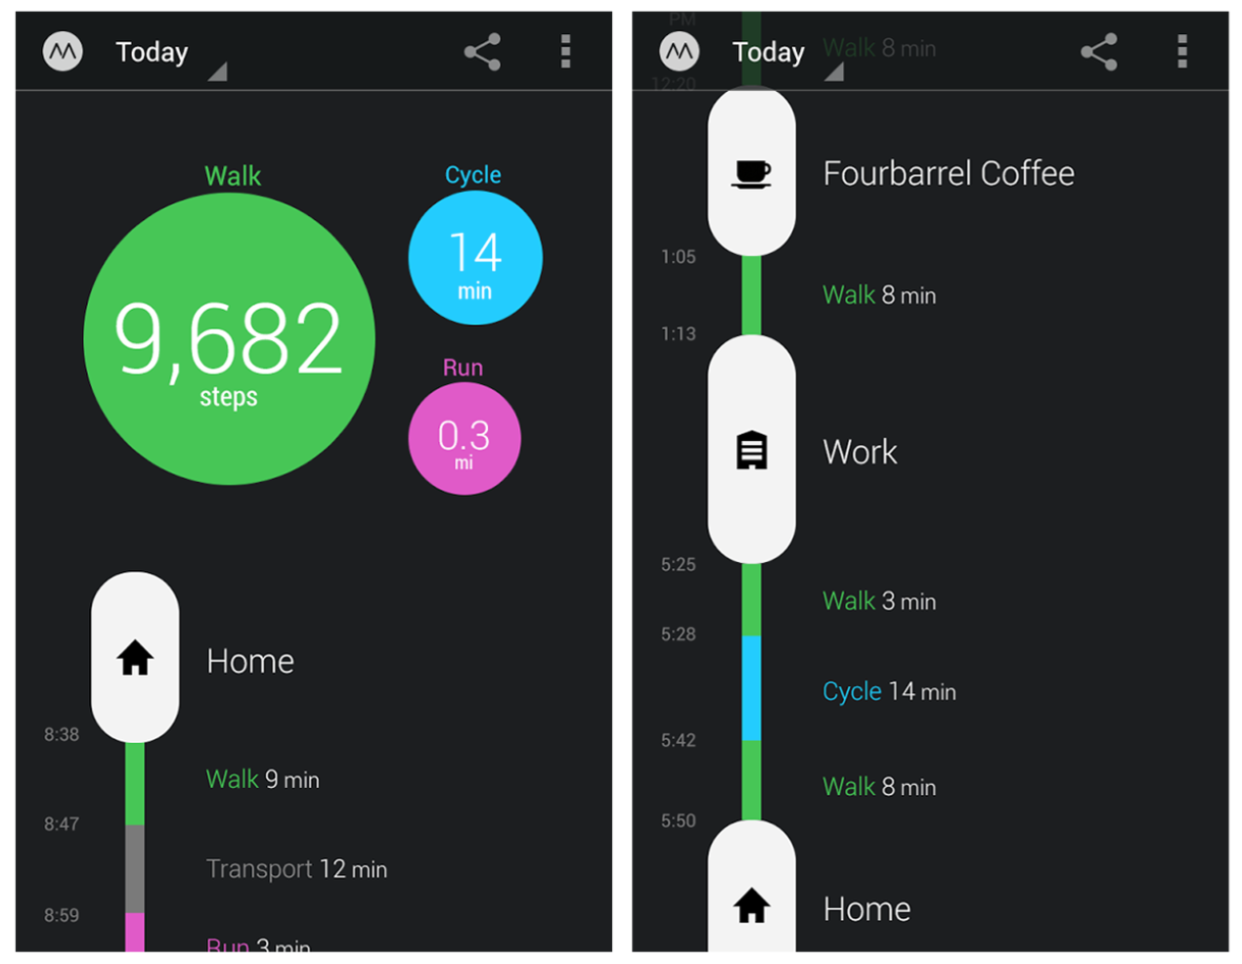
Notes:
FIGURE 6-23.
Move for Android: a different take on Overview plus Data
Use this pattern where a visual overview accompanying the detailed data will be more valuable to your users than just a list of transactions with no summary.
Another variation on this pattern is from Move for Android and iOS. The overview is a bubble chart and the detailed data is displayed below on a timeline.

Slide 31
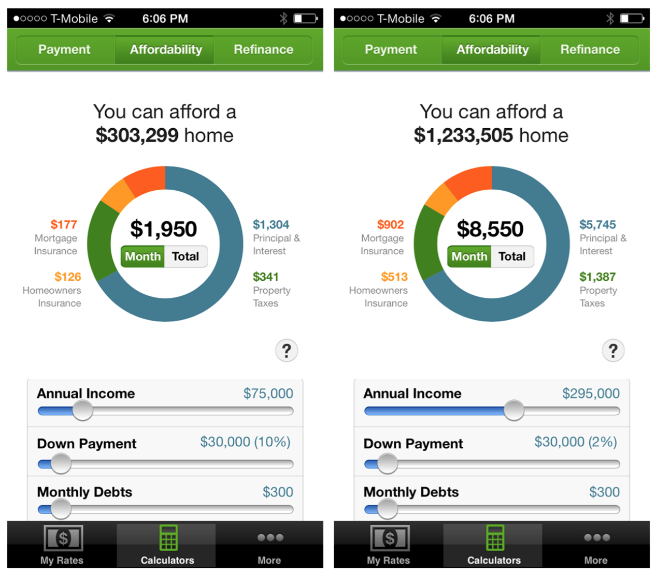
Notes:
FIGURE 6-24.
Trulia Mortgage Calculator for iOS: chart with Interactive Preview
Interactive Preview
This pattern is also covered in Chapter 2. In the example from the Trulia Mortgage Calculator, you can see that increasing my annual income from 75K to 295K using the slider on the bottom half of the page redraws the pie chart and updates the legend.

Slide 32
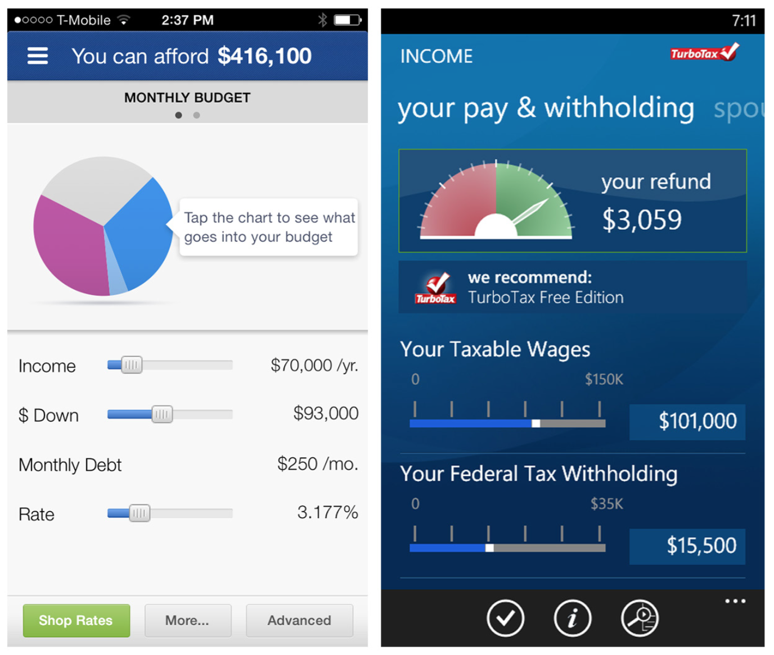
Notes:
FIGURE 6-25.
Zillow Mortgage Calculator for iOS and TaxCaster for Windows Phone: Interactive Previews
Interactive Previews are useful for displaying multiple forecast scenarios, as in personal finance applications.

Slide 33
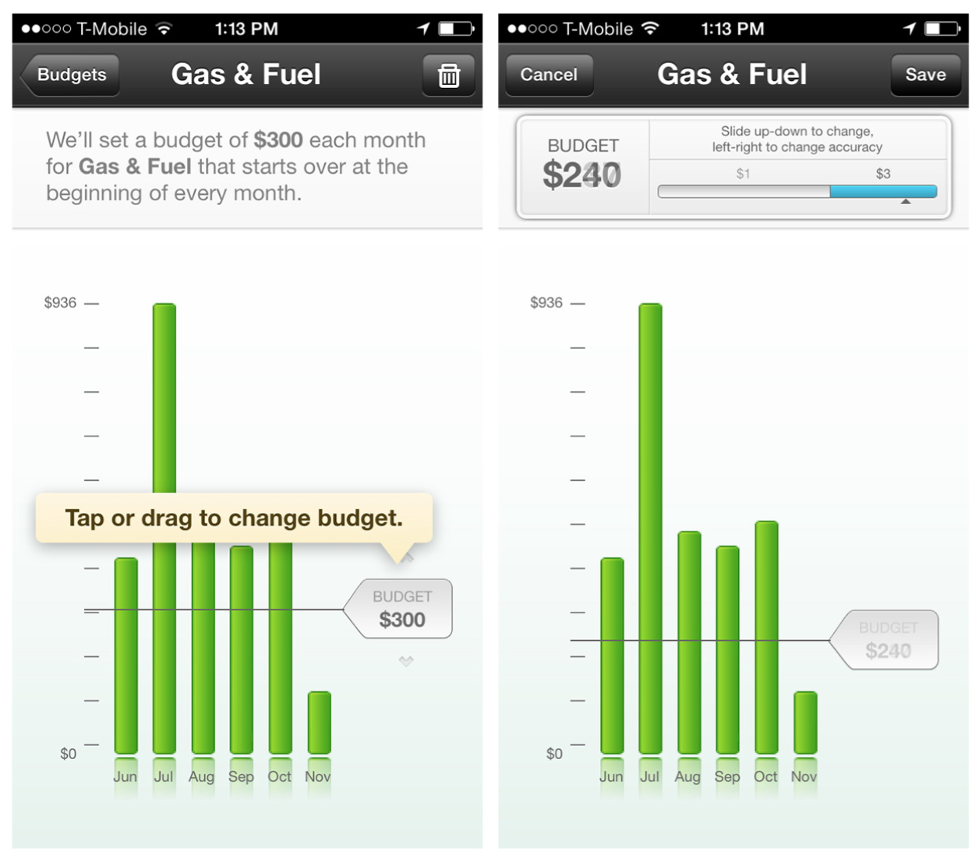
Notes:
FIGURE 6-26.
Mint for iOS: interactive chart for setting a budget

Slide 34
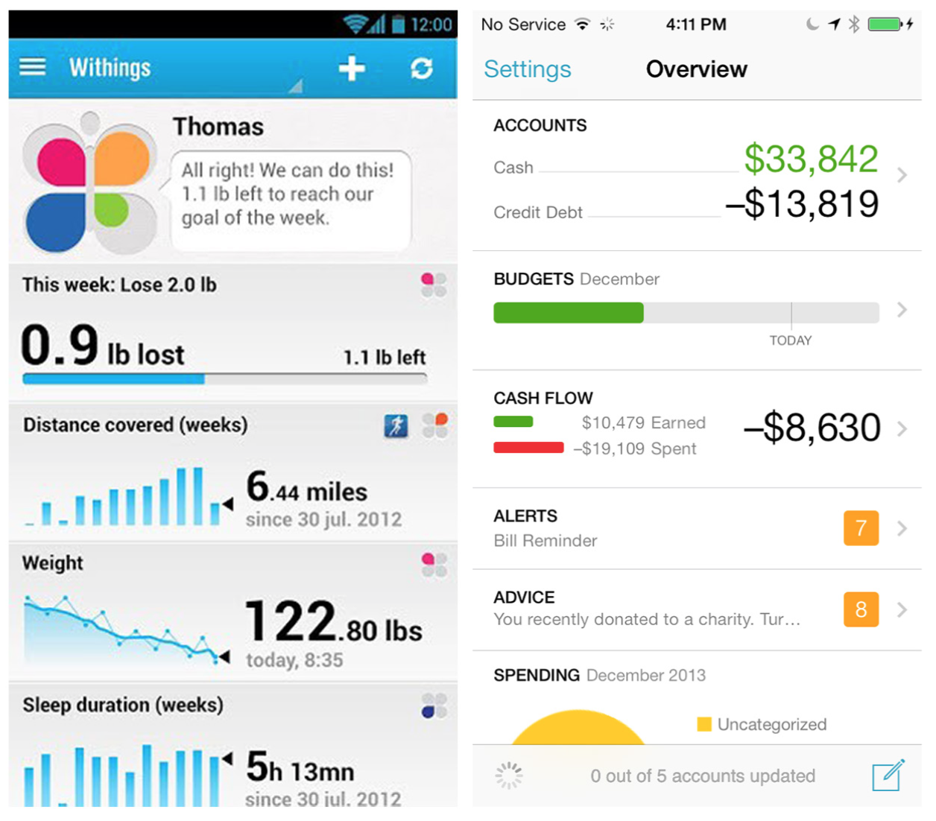
Notes:
FIGURE 6-27.
Withings for Android and Mint for iOS: Dashboard as primary navigation
Dashboard
This pattern is also covered in Chapter 1. A Dashboard can be used for primary navigation, as in Withings and Mint, which each use a Dashboard as the hub for navigating to specific modules.

Slide 35
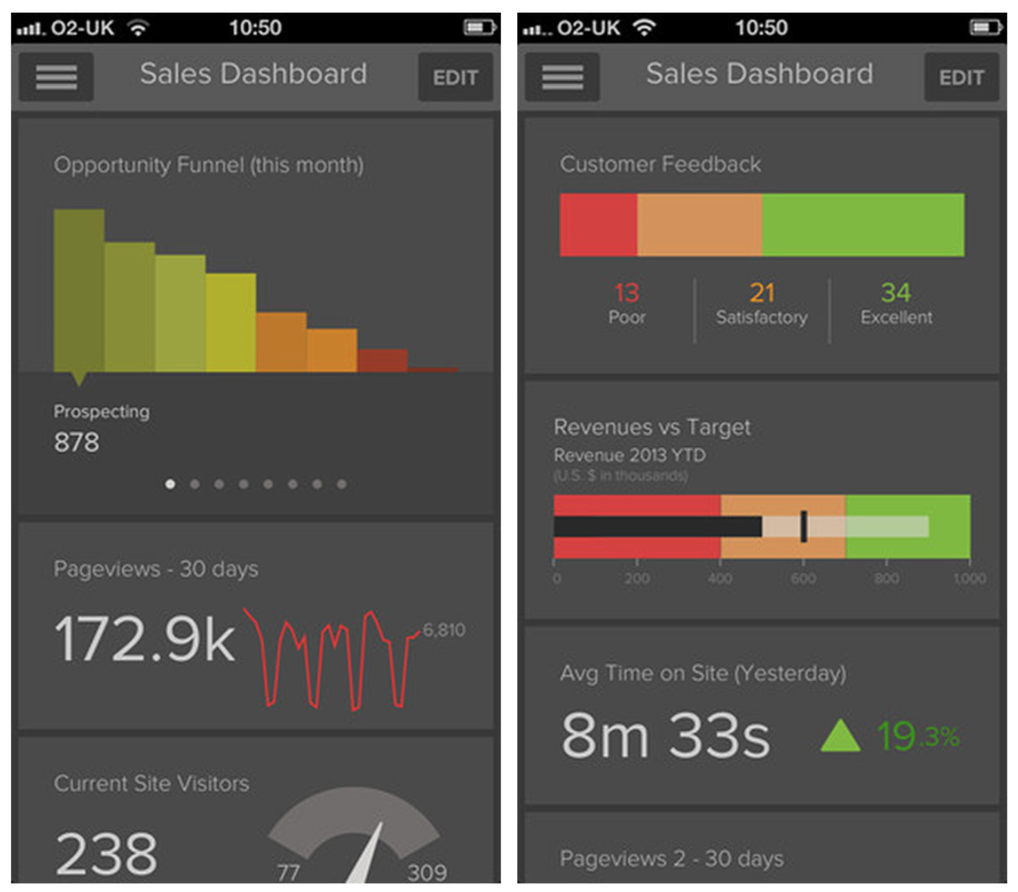
Notes:
FIGURE 6-28.
Gekoboard for iOS: customizable Dashboard
Use the Dashboard pattern if displaying multiple charts together helps tell an overarching story. Avoid it if it’s just consolidating disparate, unrelated data.

Slide 36
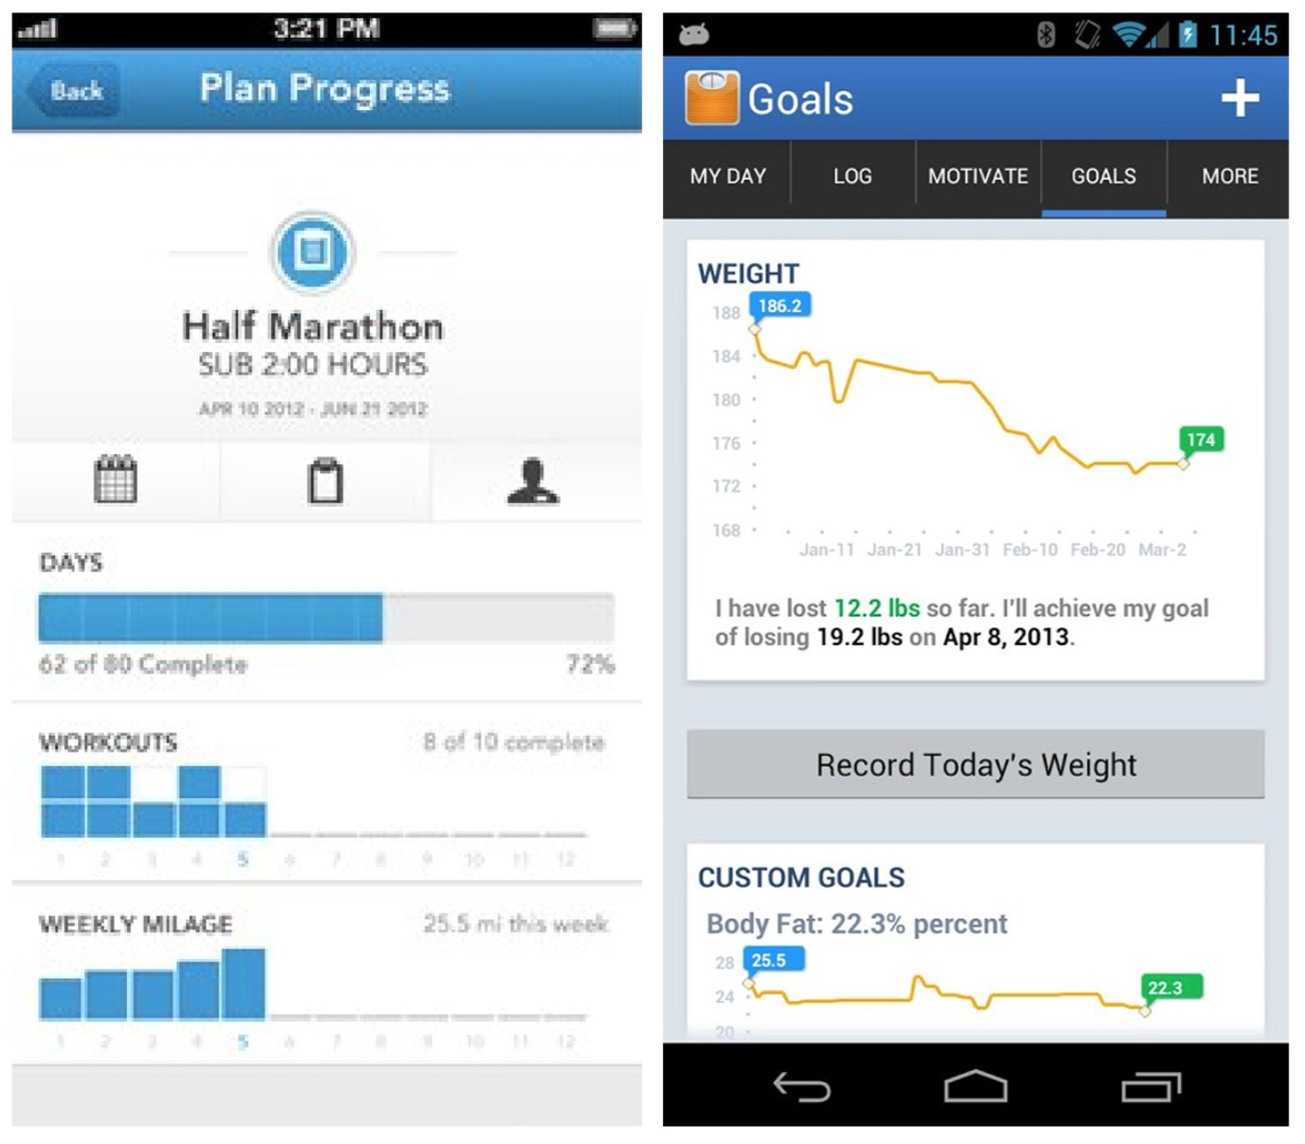
Notes:
FIGURE 6-29.
RunKeeper for iOS and Lose It! for Android: Dashboard as secondary navigation
The Dashboard also can be used for secondary navigation, as in RunKeeper for iOS and Lose It! for Android, which use multiple stacked charts to show progress against a set of goals.
Then there’s Analytiks, which uses Dashboards for primary and sec- ondary navigation. The home screen shows the website’s key perfor- mance indicators, and you can navigate to a second dashboard with detailed metrics around demographics, browsers, audience, and time on site.

Slide 37
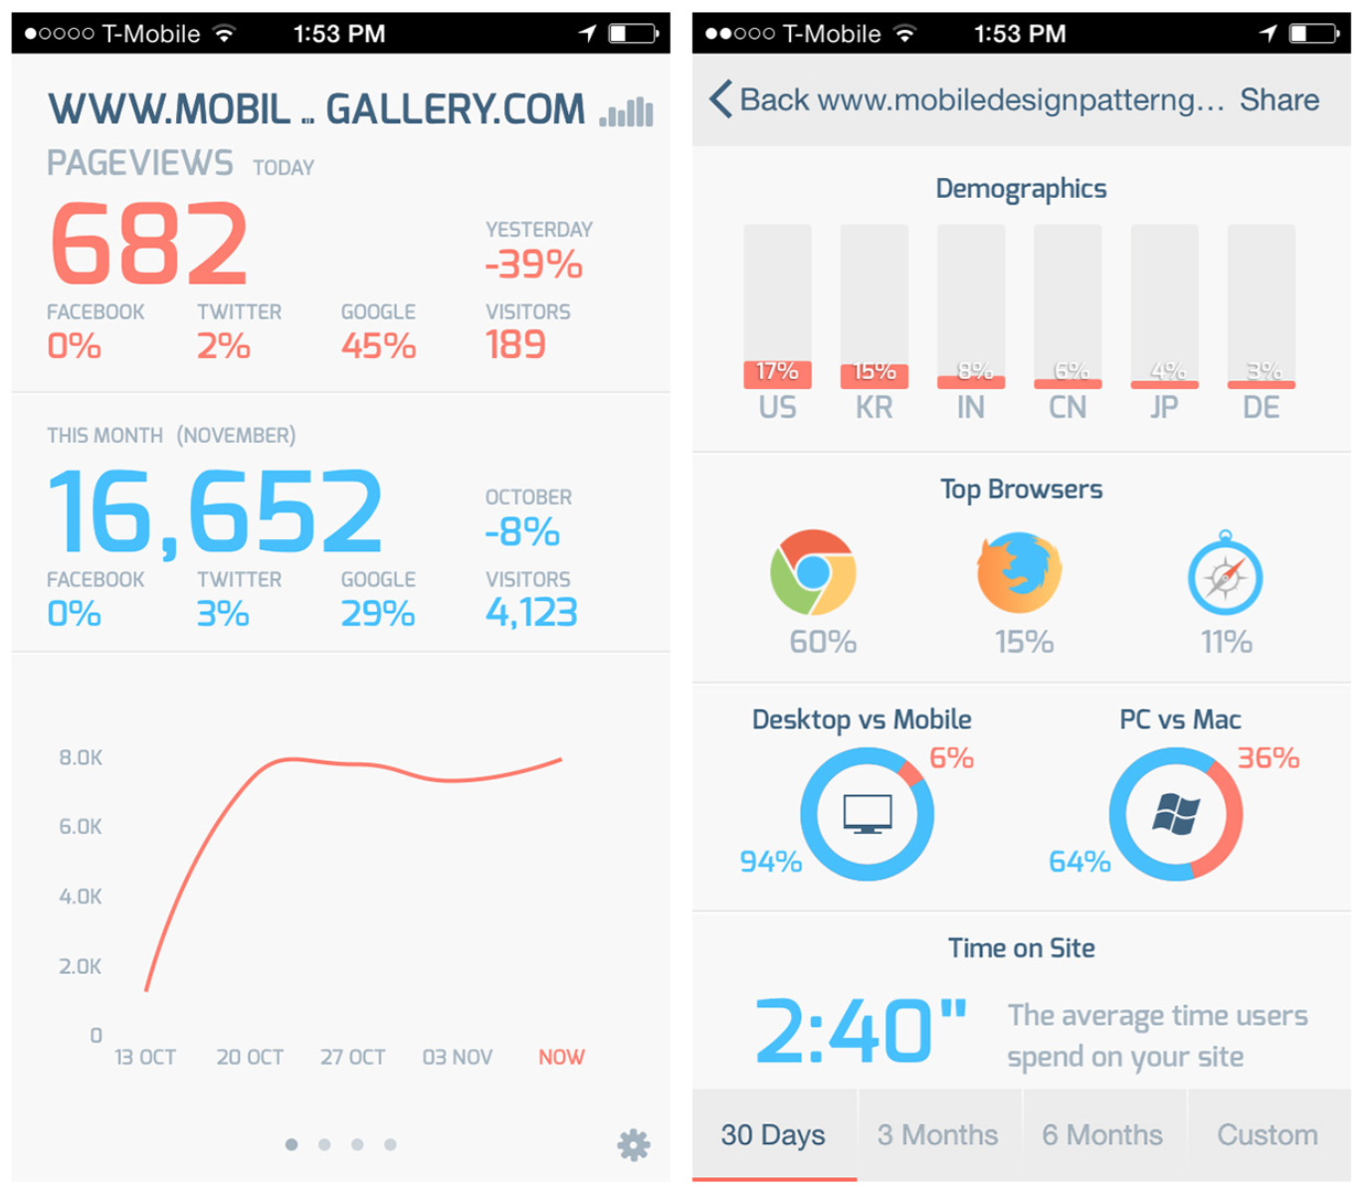
Notes:
FIGURE 6-30.
Analytiks for iOS: well- designed Dashboards as primary and secondary navigation

Slide 38
Zoom
A chart might be only one of many elements on the screen, making it difficult to read. It is common practice to invite the user to rotate her phone to get a full-screen, landscape view.
The title and navigation elements are typically hidden to give the chart as much space as possible.
Rotating the device back to portrait mode restores the navigation and other controls.
It is important to provide an invitation to rotate the device for the immersive chart view.

Slide 39
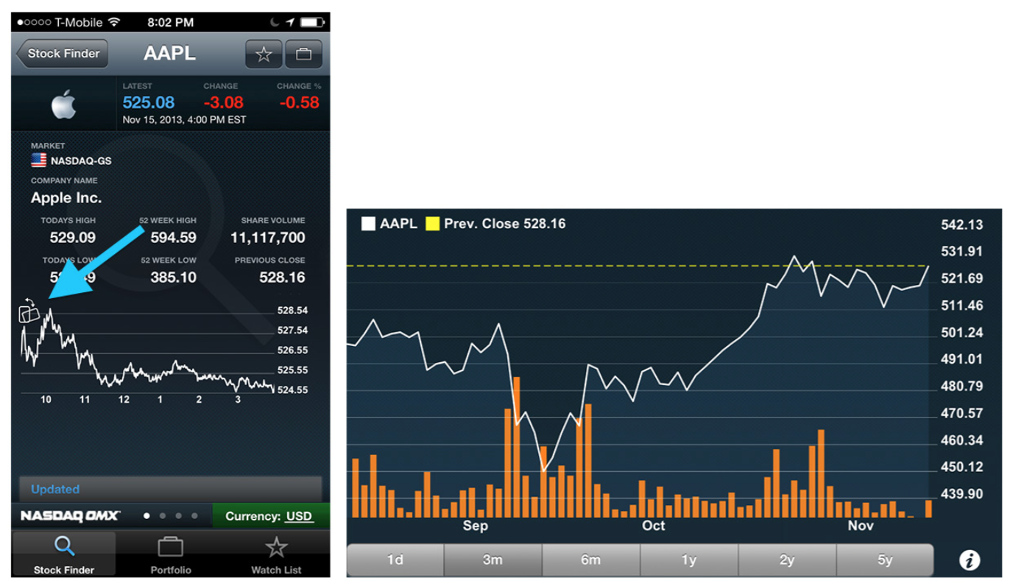
Notes:
FIGURE 6-31.
NASDAQ QMX for iOS: illustration invites user to rotate phone for detailed view
Zoom
A chart might be only one of many elements on the screen, making it difficult to read. It is common practice to invite the user to rotate her phone to get a full-screen, landscape view. The title and navigation ele- ments are typically hidden to give the chart as much space as possible. Rotating the device back to portrait mode restores the navigation and other controls.
It is important to provide an invitation to rotate the device for the immersive chart view. NASDAQ QMX uses a little illustration of a rotated phone, whereas SigFig shows a prompt to rotate the device when the chart is tapped.

Slide 40
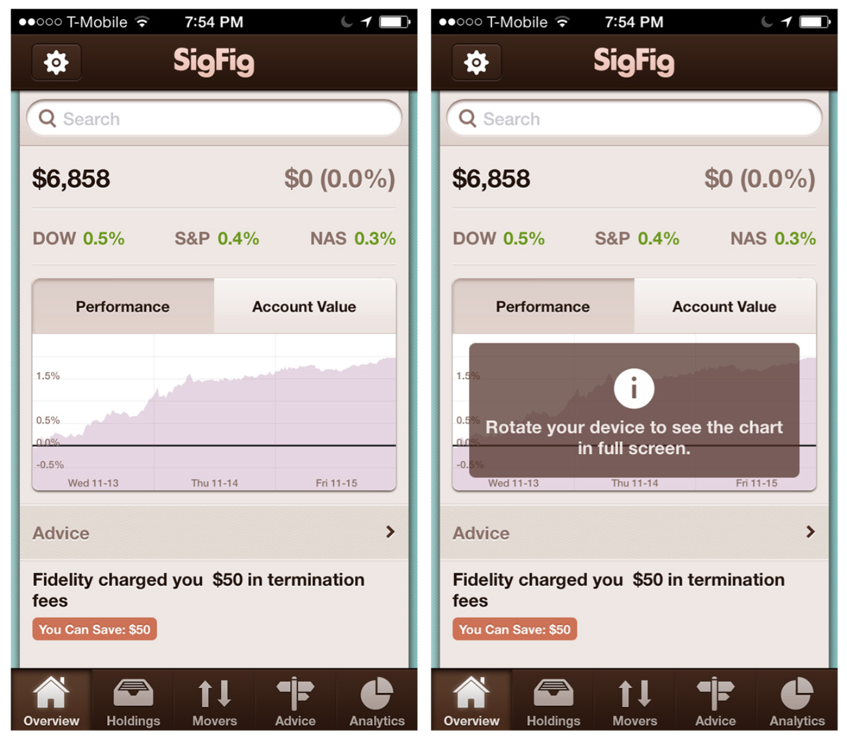
Notes:
FIGURE 6-32.
SigFig for iOS: tapping chart brings up prompt to rotate for detailed view

Slide 41
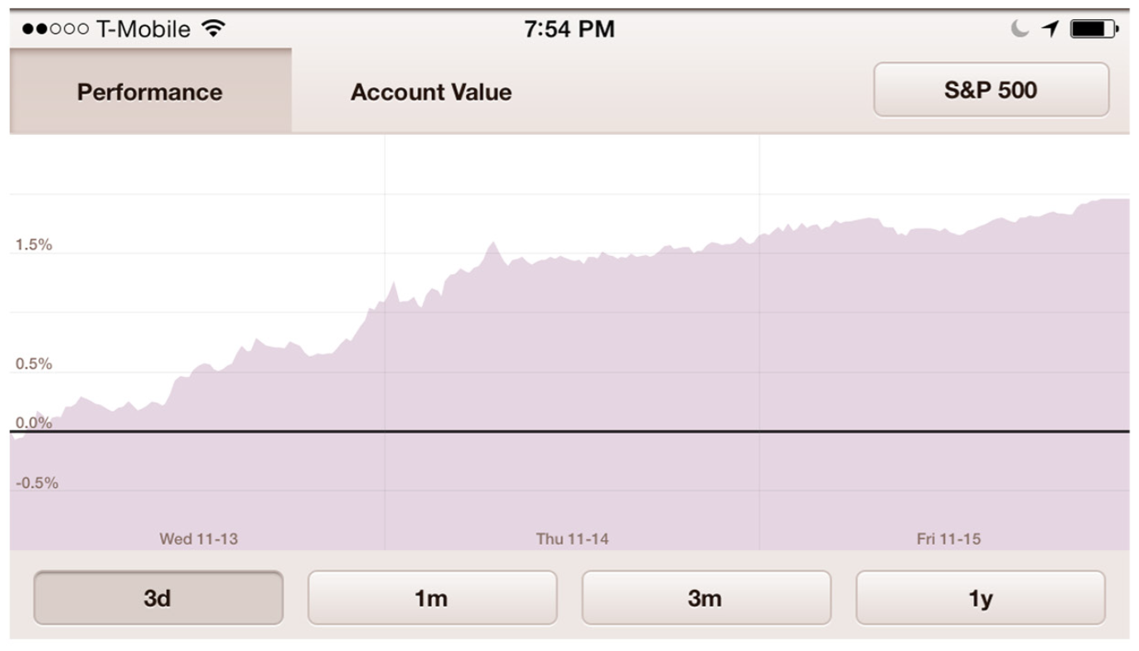
Notes:
FIGURE 6-32. (Continued)
SigFig for iOS: tapping chart brings up prompt to rotate for detailed view

Slide 42
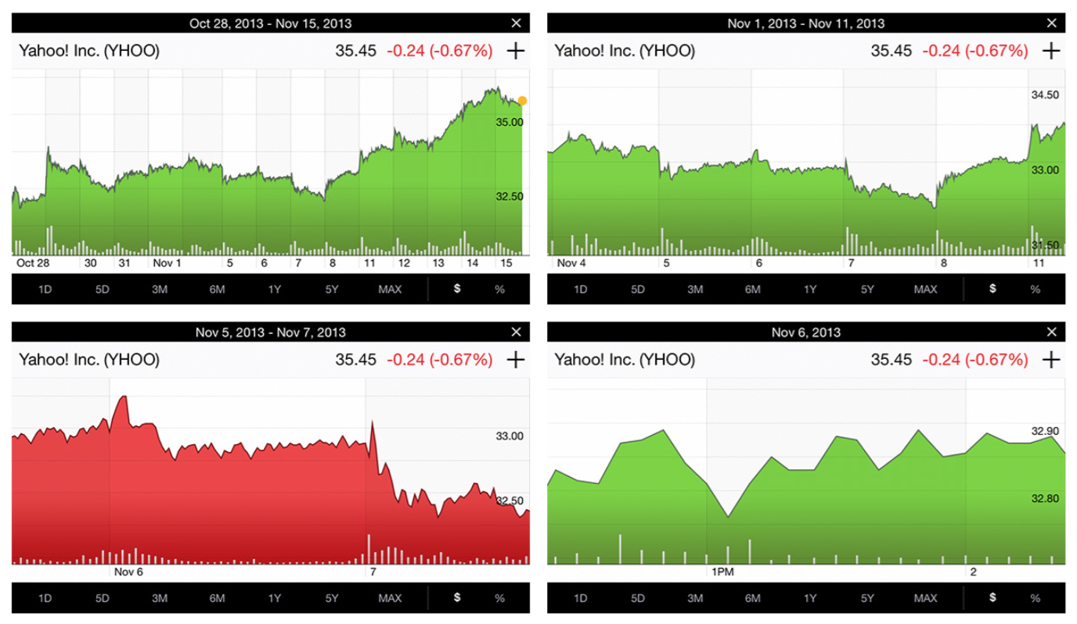
Notes:
FIGURE 6-33.
Yahoo! for iOS: pinch/ zoom in landscape view allows for adjusting time frame focus

Slide 43
Sparklines
The Sparkline, also called a microchart, is credited to visual information design guru Edward Tufte, who defines it as “a small intense, simple, word-sized graphic.”
Sparklines are particularly well suited for mobile since they provide an overview of a trend or variation in the data without using much space.

Slide 44
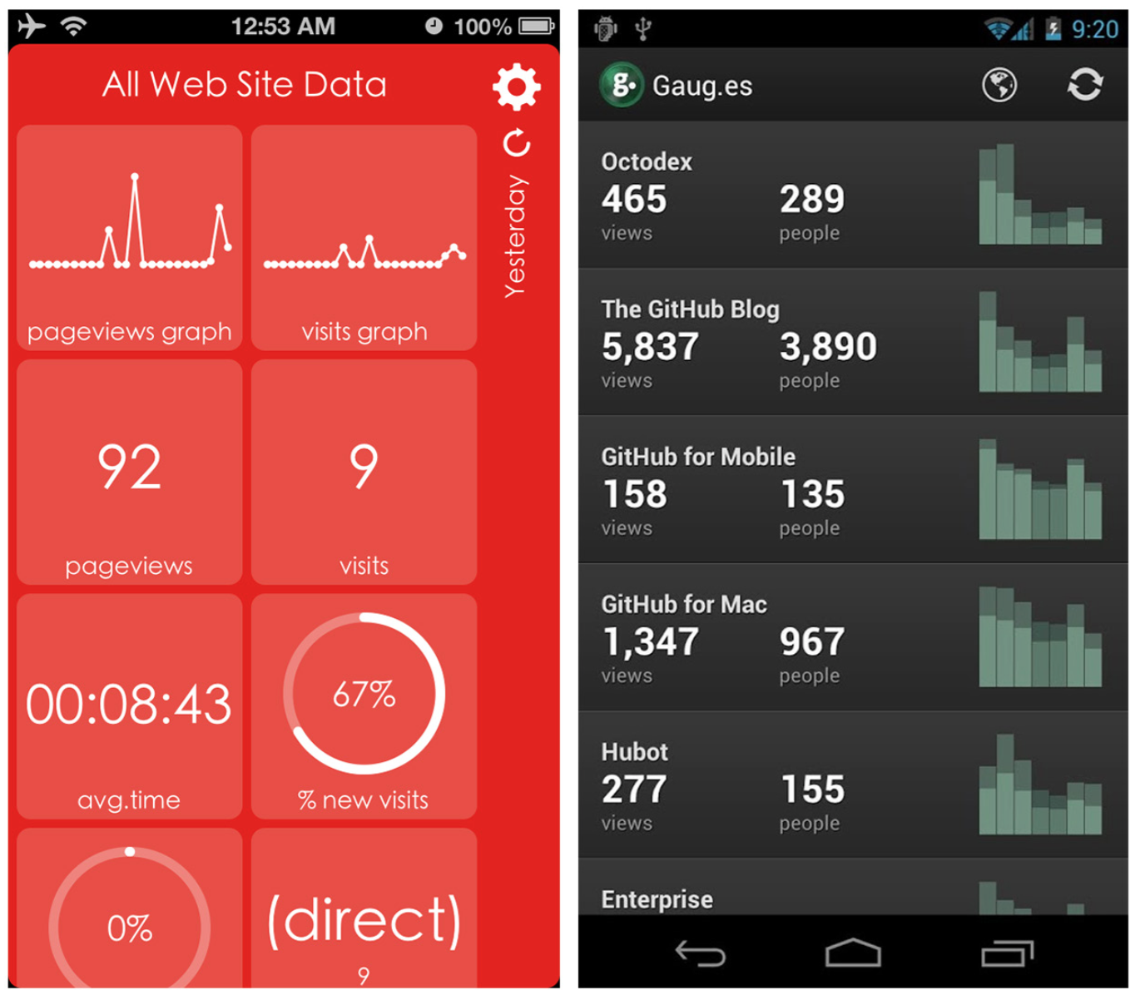
Notes:
FIGURE 6-34.
Analytics Tiles for iOS and Gaug.es for Android: Sparkline examples
Use Sparklines to provide a quick visual hit of information, but always validate their clarity in user testing. Consider using Sparklines as the entry point to a Drill Down into a more detailed view.

Slide 45
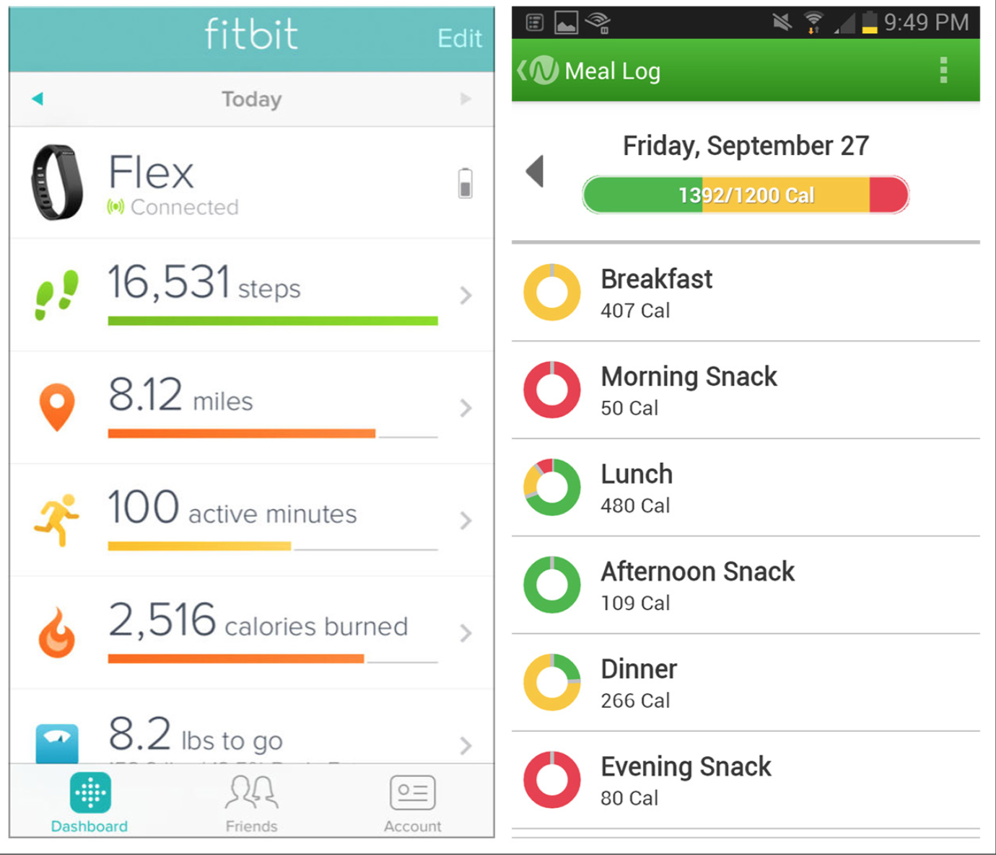
Notes:
FIGURE 6-35.
Fitbit for iOS and Noom for Android: more examples of Sparklines

Slide 46
Integrated Legend
Another technique to save space is to integrate the legend into either the title of the chart or the data table below.

Slide 47
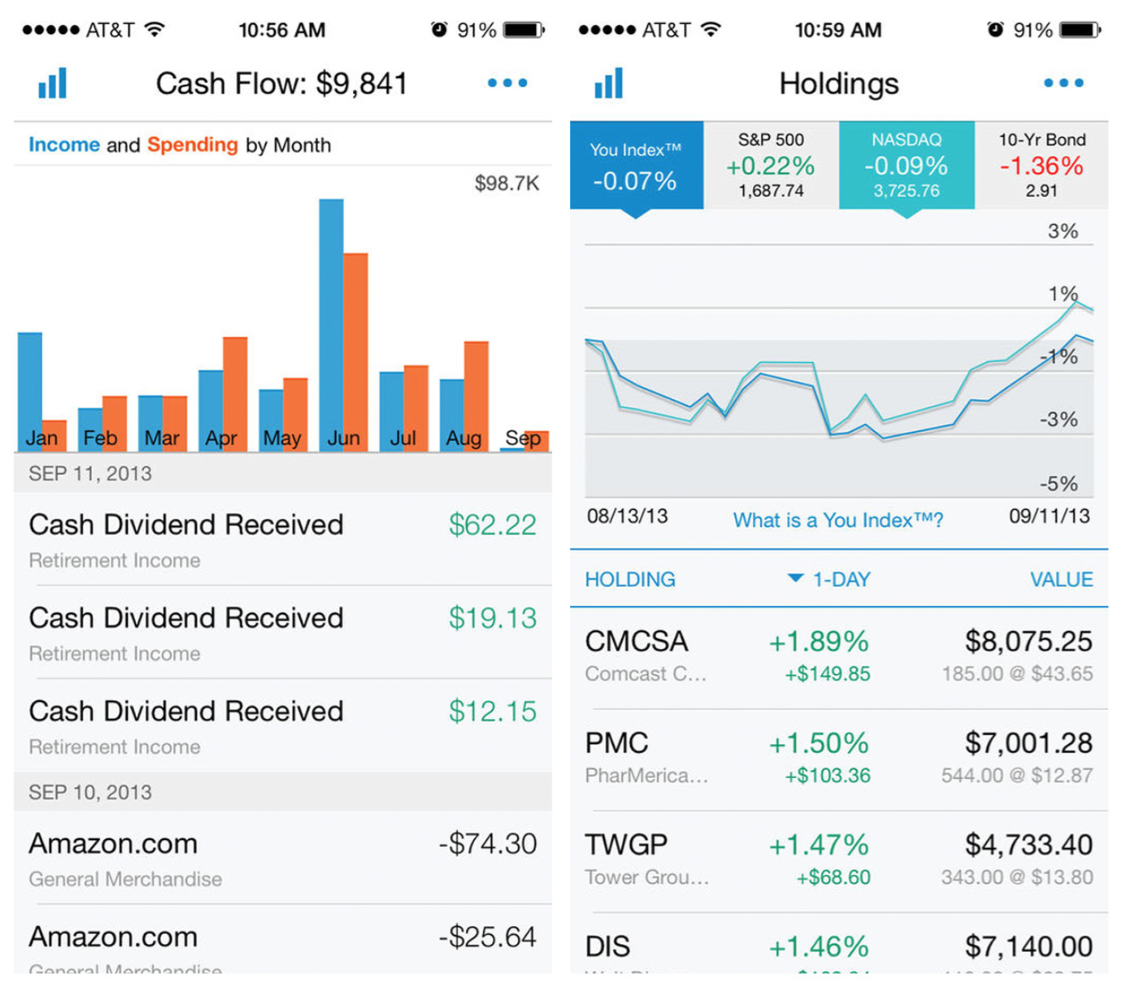
Notes:
FIGURE 6-36.
Personal Capital for iOS: Integrated Legends in title (left) and data table (right)

Slide 48
Thresholds
Many charts use this pattern to communicate if data is in or out of range, or on or off target.
Thresholds can be communicated by use of color, bands, or lines on charts.

Slide 49
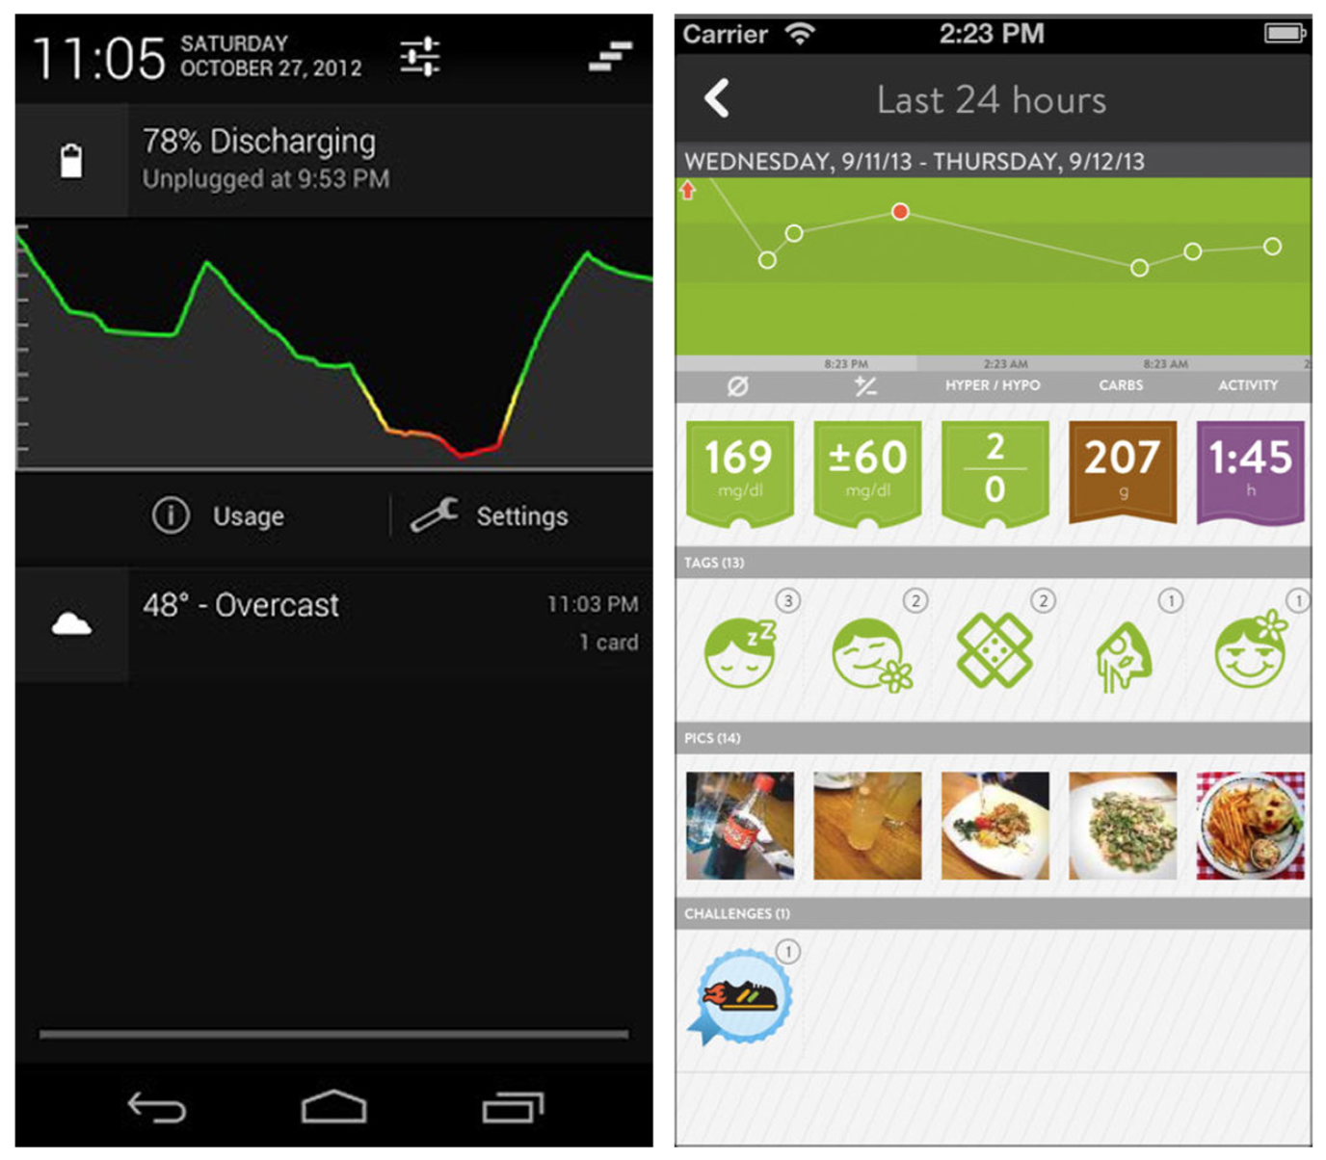
Notes:
FIGURE 6-37.
Battery Graph Notification for Android and MySugr for iOS: colors indicate data in or out of target range

Slide 50
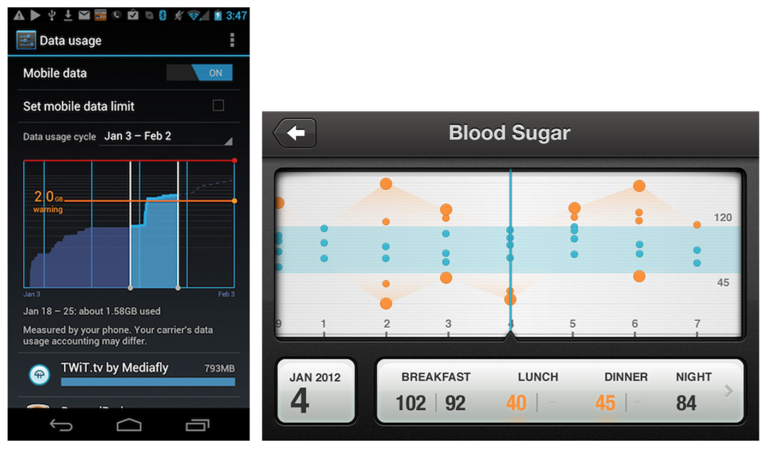
Notes:
FIGURE 6-38.
Data Usage for Android and Diabetes concept app by Anthony Lagoon: Threshold line and band, respectively

Slide 51
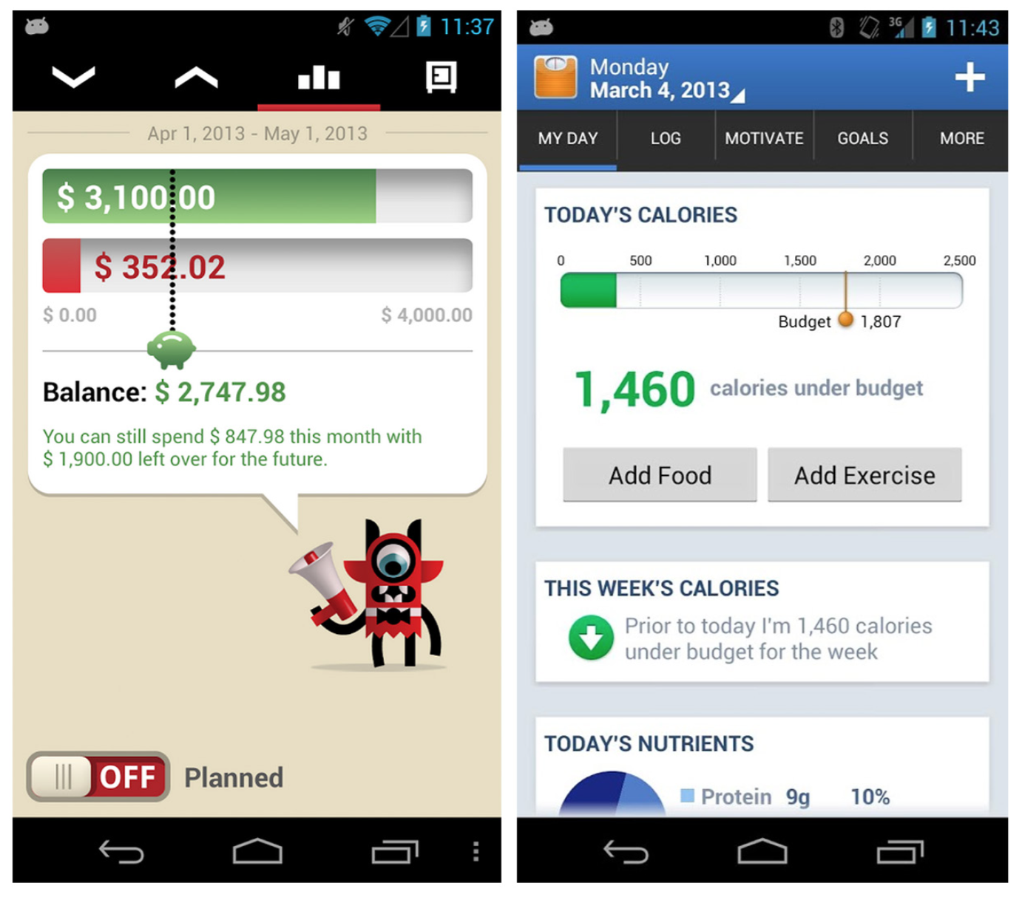
Notes:
FIGURE 6-39.
Toshl for Windows Phone and Lose It! for Android: more Threshold designs
Thresholds are particularly useful for marking personal user goals. Consider making the Threshold marker interactive (i.e., adjustable within the chart).

Slide 52
Pivot Table
Pivot Tables are small summary tables within larger tables. In popular desktop and web spreadsheet applications, for example, the user can build a Pivot Table by dragging and dropping the values to be included in the summary.
By moving these values around, the user can “pivot” the table to display the data in multiple ways.

Slide 53
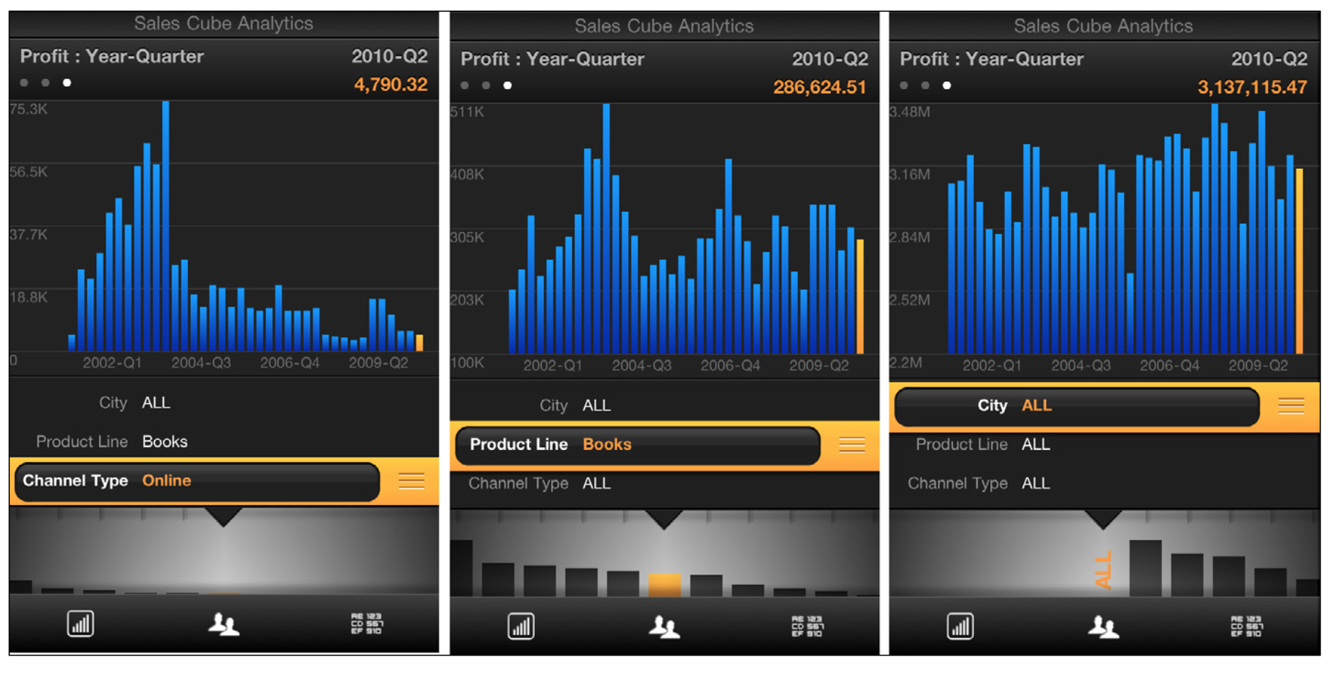
Notes:
FIGURE 6-40.
Roambi for iOS 6: Pivot Table–style filtering

Slide 54
Pulling It All Together
Now let’s look at some examples from apps that really use charts well.

Slide 55
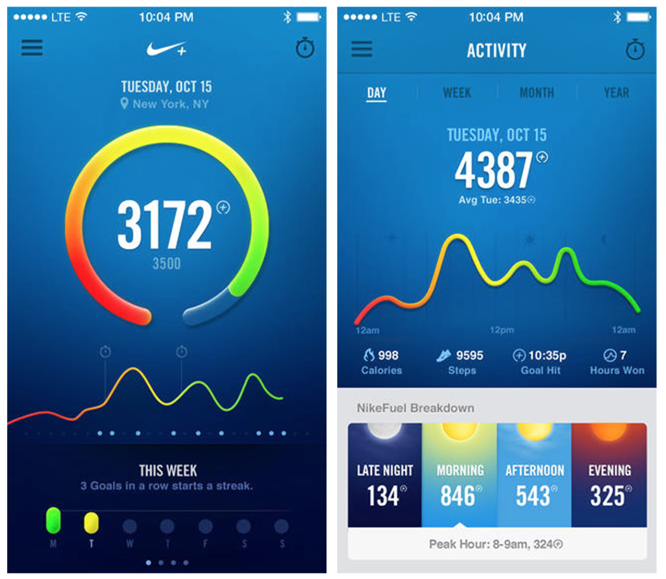
Notes:
FIGURE 6-41.
Nike+ FuelBand for iOS: clean and clear data visualizations throughout
The Nike+ FuelBand app does a fantastic job of presenting clean and clear data visualizations to motivate users. Its designers selected the best chart types for communicating progress on different goals, and avoided the temptation to overload the screens with chart junk. Each chart is clearly titled and the axes are clearly labeled. The app estab- lishes a Threshold color palette and uses it consistently throughout. Regardless of the chart type, the low end of the progress and perfor- mance spectrum is always shown in red, and the top end is always green.

Slide 56
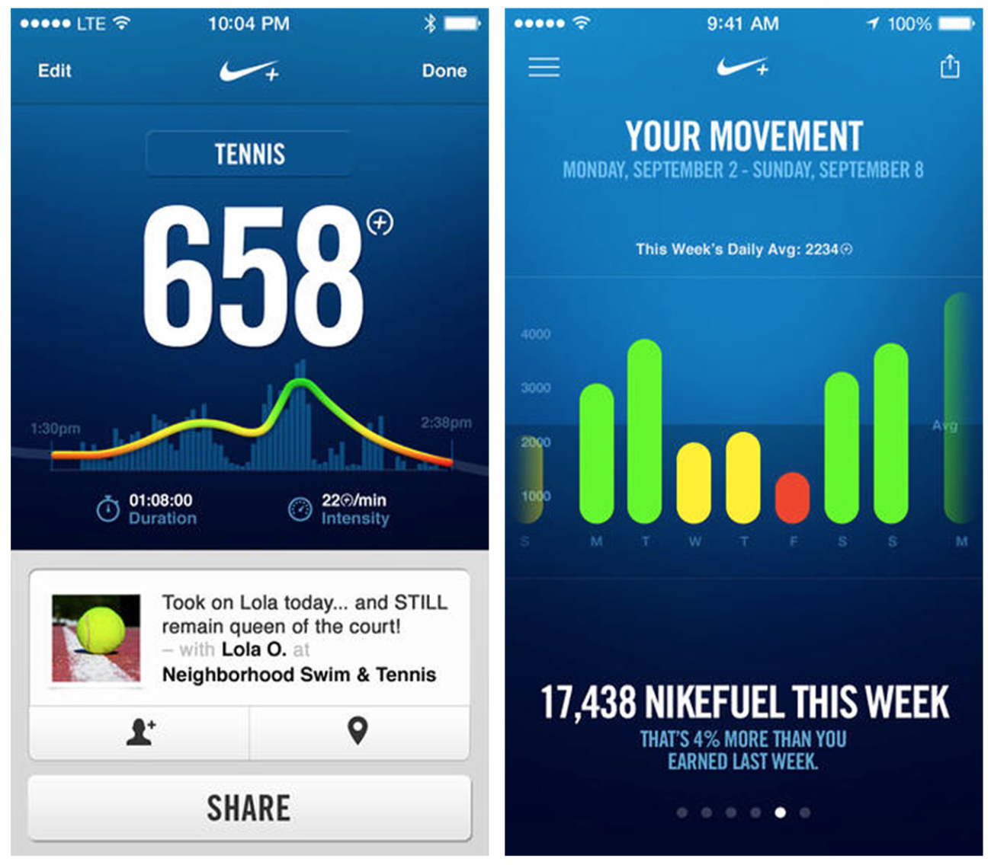
Notes:
FIGURE 6-41. (Continued)
Nike+ FuelBand for iOS: clean and clear data visualizations throughout

Slide 57
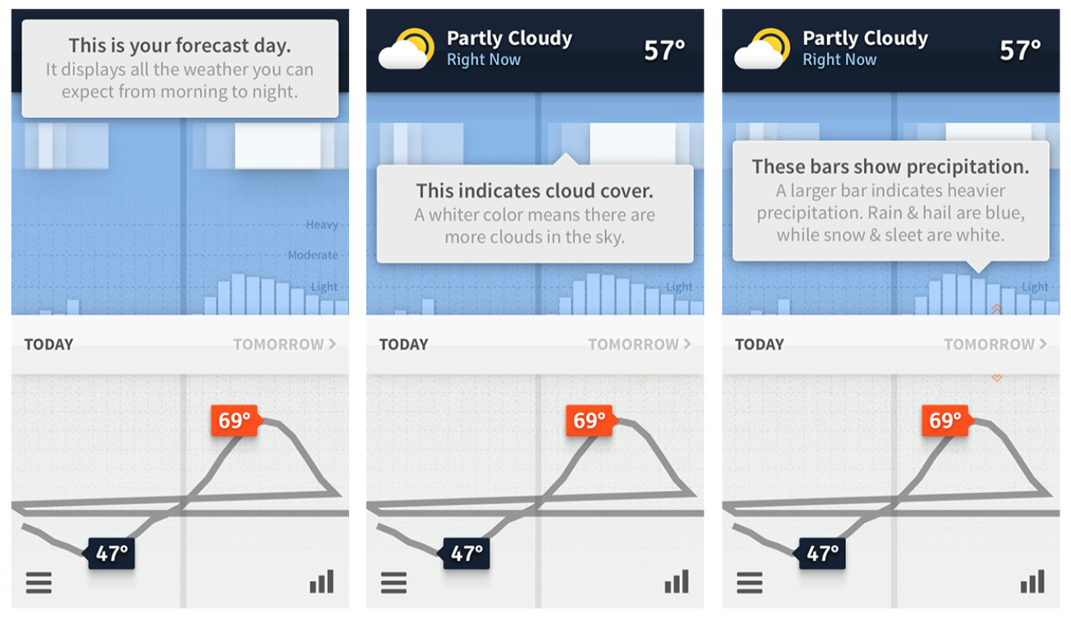
Notes:
FIGURE 6-42.
Weathertron for iOS: well-designed, simple, and intuitive data visualizations
Weathertron is another fine example of well-designed data visual- ization. While the first-time tutorial experience could benefit from a redesign featuring embedded invitations (as outlined in Chapter 8), the app UX itself is simple and intuitive. The compact bar chart in the drawer accessed at lower right, for example, is the perfect way to show the highs and lows for the seven-day forecast.

Slide 58
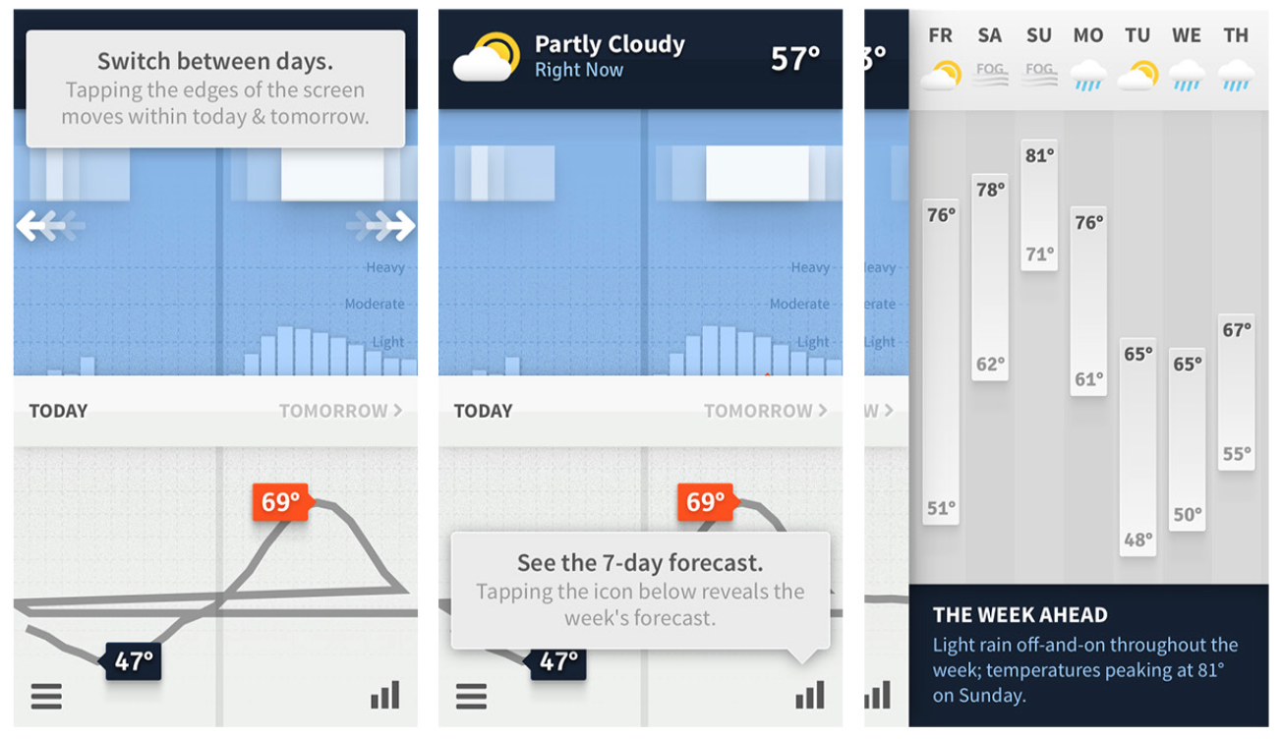
Notes:
FIGURE 6-42. (Continued)
Weathertron for iOS: well-designed, simple, and intuitive data visualizations

